Slide 1
Ethical Control of Unmanned Systems Ethical Control of Unmanned Systems using Formal Mission Ontologies for Undersea Warfare
NDIA 2020 Undersea Warfare Virtual Conference
Don Brutzman
Naval Postgraduate School (NPS)
4 September 2020
Notes:
Distribution is unrestricted. See Open-Source License for Ethical Control for details controlling this work.

Slide 2
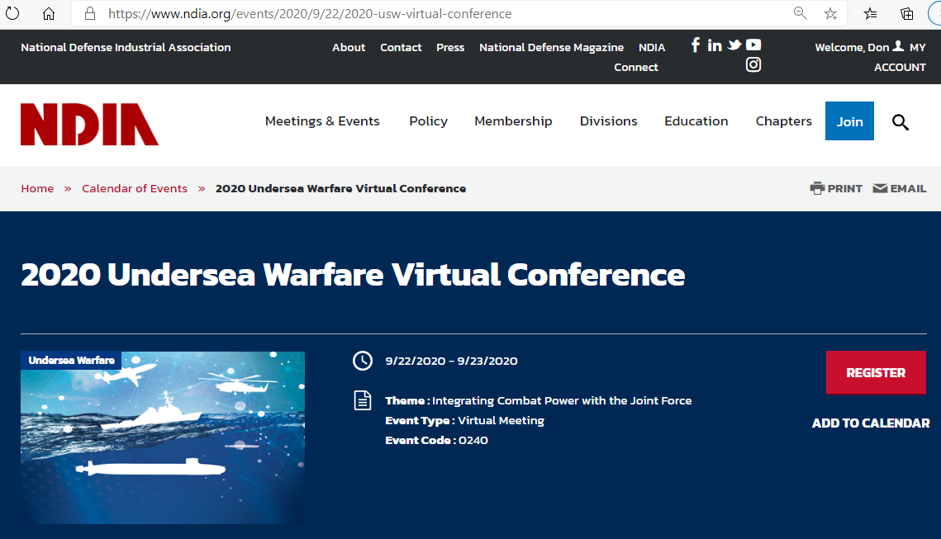
NDIA 2020 Undersea Warfare Virtual Conference
Notes:
https://www.ndia.org/events/2020/9/22/2020-usw-virtual-conference

Slide 3
Conference theme: Integrating Combat Power with the Joint Force
Joint Force is increasingly interdepending on Undersea Warfare as conflict potential grows across the world
Alfred Thayer Mahan: command of the sea, even if local and temporary, naval operations in support of land forces holds decisive importance. (Wikipedia)
Command Control Communications Intelligence (C4I) working group efforts are fundamentally important.
USW forces must be capable of jointly coordinating C2 of systems holding direct potential for lethal force, despite intermittent communications, over long distances and long durations of time.

Slide 4
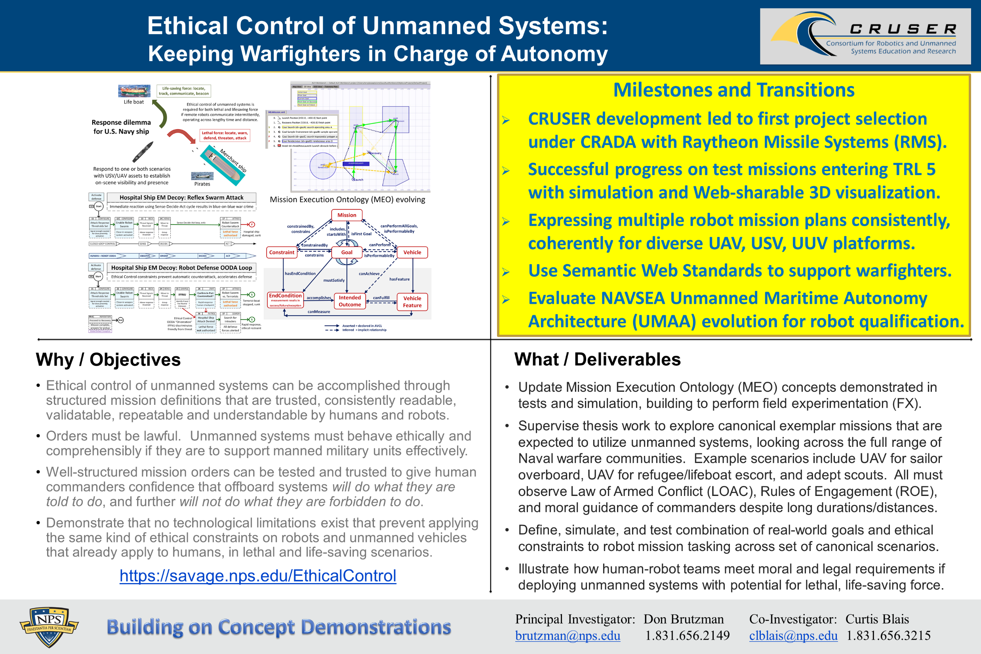
Ethical Control quad chart

Slide 5
Synopsis: Ethical Control of Unmanned Systems
Project Motivation: ethically constrained control of unmanned systems and robot missions by human supervisors and warfighters.
Precept: well-structured mission orders can be syntactically and semantically validated to give human commanders confidence that offboard systems
will do what they are told to do, and further
will not do what they are forbidden to do.
Project Goal: apply Semantic Web ontology to scenario goals and constraints for logical validation that human-approved mission orders for robots are semantically coherent, precise, unambiguous, and without internal contradictions.
Long-term Objective: demonstrate that no technological limitations exist that prevent applying the same kind of ethical constraints on robots and unmanned vehicles that already apply to human beings.
Paraphrase: can qualified robots correctly follow human orders?

Slide 6
Open-Source Licensing for Ethical Control
All NPS work is published as open source with no restrictions on use.
https://savage.nps.edu/EthicalControl/license.html (also .txt)
An excellent heuristic is to assume success – then what?
Ethical Control of unmanned systems is critically important worldwide.
Ethical Control must be unambiguously defined in order to be actionable by humans (military professionals) under all conditions facing U.S. military.
Ethical Control must be implementable across a totally diverse set of evolving unmanned and C2 systems (both open and closed) in order to be effective.
Ethical Control concepts, syntax definitions and semantic relationships for lethal/lifesaving force thus cannot be subject to proprietary restrictions.

Slide 7
Background History
Many years of work have composed multiple fields of study to provide techniques for maintaining human ethical control of unmanned systems.
In this work, ethical theory meets professional practice. Each step must work for human commanders and unmanned systems alike.

Slide 8
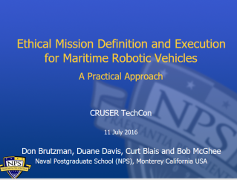
Key Insights regarding Human Ethical Control
Humans in military units are able to deal with moral challenges without ethical quandaries,
by using formally qualified experience, and by following mission orders that comply with Rules of Engagement (ROE) and Laws of Armed Conflict (LOAC).
Ethical behaviors don’t define the mission plan. Instead, ethical constraints inform the mission plan.
Naval forces can only command mission orders that are
Understandable by (legally culpable) humans, then
Reliably and safely executed by robots.
Reference: CRUSER TechCon Overview 2016
https://gitlab.nps.edu/Savage/EthicalControl/tree/master/documents/presentations
Notes:
Laws of Armed Conflict (LOAC) are also referred to as International Humanitarian Law (IHL).

Slide 9
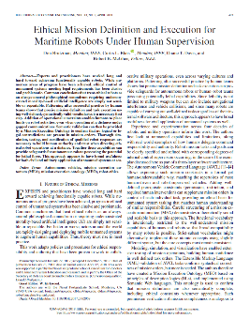
Ethical Mission Definition and Execution for Maritime Robots Under Human Supervision
Theoretical Basis
Don Brutzman, Curtis L. Blais, Duane T. Davis, Robert B. McGhee
IEEE Journal of Oceanic Engineering (JOE), Volume: 43 , Issue: 2 , April 2018
Abstract. Experts and practitioners have worked long and hard toward achieving functionally capable robots. While numerous areas of progress have been achieved, ethical control of unmanned systems meeting legal requirements has been elusive and problematic. Common conclusions that treat ethical robots as an always-amoral philosophical conundrum requiring undemonstrated morality-based artificial intelligence are simply not sensible or repeatable. Patterning after successful practice by human teams shows that precise mission definition and task execution using well-defined, syntactically valid vocabularies is a necessary first step. Addition of operational constraints enables humans to place limits on robot activities, even when operating at a distance under gapped communications. Semantic validation can then be provided by a Mission Execution Ontology to confirm that no logical or legal contradictions are present in mission orders. Thorough simulation, testing, and certification of qualified robot responses are necessary to build human authority and trust when directing ethical robot operations at a distance. Together these capabilities can provide safeguards for autonomous robots possessing the potential for lethal force. This approach appears to have broad usefulness for both civil and military application of unmanned systems at sea.
Notes:
https://ieeexplore.ieee.org/document/8265218

Slide 10
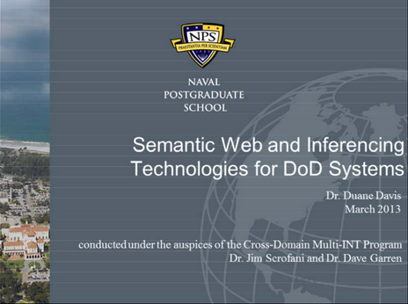
Semantic Web and inferencing technologies for Department of Defense systems
Duane Davis, NPS Technical Report NPS-CMIS-14-001, 2014
Available via https://calhoun.nps.edu/handle/10945/43723 (report) (slideset)
Abstract. Operational commanders and intelligence professionals are provided with a continually-increasing volume of data from numerous sources. Effective utilization of this data can be hampered by difficulties in fusing different data streams for presentation, correlating related data from various sources and developing reliable summary and predictive products. An opportunity presently exists to improve this situation through the incorporation of Semantic Web technologies into Department of Defense (DOD) systems. This report provides a didactic overview of Description Logics (DL) and their implementation in Semantic Web languages and technologies to include the mathematical properties supporting robust knowledge representation. Subsequently, the algorithms for automated reasoning and inferencing with DLs are discussed. Included in this discussion is a comparison of available Semantic Web applications for ontology development and realization or DL reasoning capabilities with real-world knowledge bases. Finally, mechanisms for applying artificial intelligence techniques to ontological DL information are presented.

Slide 11
Description Logic (DL) Rules provide basis for Mission Execution Ontology (MEO)
Rules | Description Logic Equations | Plain-language description
M = Mission Rules
M1 | Mission ⊑ ∀startsWith.Goal ⊓ =1startsWith.Goal | A Mission can only start with a Goal and must start with exactly one Goal
M2 | Mission ⊑ ∀includes.Goal ⊓ ≥1includes.Goal | A Mission can only include Goals and must include one of more Goals
M3 | Mission ⊑ ∀hasConstraint.Constraint | A Mission can only be constrained by Constraints
M4 | startsWith ⊑ includes | A Mission must include the Goal that it starts with
M5 | Mission ⊑ ∀performableBy.Vehicle | A Mission can only be performed by a Vehicle
M6 | Cannot be expressed in DL | A Mission cannot be performable by a Vehicle unless that Vehicle has the ability to identify all Constraints associated with that mission
M7 | Cannot be expressed in DL | A Mission cannot be performable by a Vehicle unless that Vehicle has the capability to accomplish all Goals included in that Mission
Excerpted from full
Mission Execution Ontology Decision Logic Tables
Original author:
Duane Davis

Slide 12
Mission Representation using Autonomous Vehicle Command Language (AVCL)
Structured vocabulary to define unmanned-system missions, understandable by human commanders, useful in multiple programming languages plus Semantic Web logical queries.

Slide 13
Autonomous Vehicle Command Language (AVCL)
AVCL is a command and control language for humans supervising autonomous unmanned vehicles.
Clarity arises from close correspondence to human naval terminology.
Structured vocabulary defining terms and relationships for mission planning, execution, conduct, recording and replay across diverse robot types.
Common-ground XML representations for
Mission agenda plans, mission scripts, and post-mission recorded telemetry results.
Future work: defining unit tests and expected results for verification and validation.
Operators have single archivable, validatable format for robot tasking, results
directly convertible to and from a wide variety of different robot command languages.
Mission Tasking
https://savage.nps.edu/Savage/AuvWorkbench/AVCL/AVCL.html

Slide 14
Example AVCL mission agenda, as pseudo-code XML
<?xml version="1.0" encoding="UTF-8"?>
<UUVMission>
<GoalSet>
<Goal area=”A” id=”goal1”>
<Search nextOnSuccess=”goal2” nextOnFailure=”goal3”/>
</Goal>
<Goal area=”A” id=”goal2”>
<SampleEnvironment nextOnSuccess=”goal3”
nextOnFailure=”recover”/>
</Goal>
<Goal area=”B” id=”goal3”>
<Search nextOnSuccess=”goal4” nextOnFailure=”goal4”/>
</Goal>
<Goal area=”C” id=”goal4”>
<Rendezvous nextOnSuccess=”recover” nextOnFailure=”recover”/>
</Goal>
<Goal area=”recoveryPosition” id=”recover”>
<Transit nextOnSuccess=”missionComplete” nextOnFailure=”missionAbort”/>
</Goal>
</GoalSet>
</UUVMission>
AVCL is readable by human or robot,
captures logic of mission tasking
XML ensures syntactically correct, well-defined, numerically valid
Needed: semantic representation
to check ethical, logical consistency

Slide 15
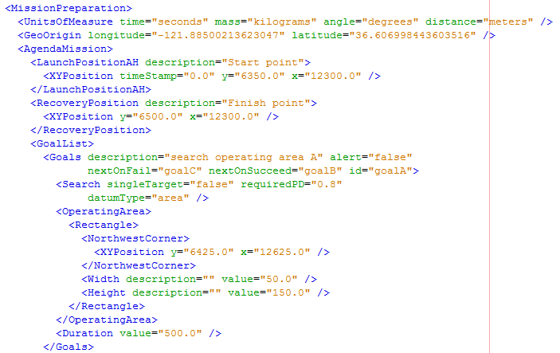
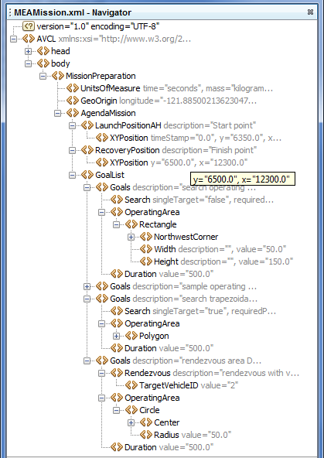
Corresponding example: MEAMission.xml using AVCL document

Slide 16
AVCL mission goals vocabulary (Davis 2015)
AVCL mission goals | Define | Used | Definition
Attack | partial | √ | To conduct a type of offensive action characterized by employment of firepower and maneuver to close with and destroy an enemy.
Decontaminate | √ |  | To provide purification making an area safe by absorbing, destroying, neutralizing, making harmless, or removing chemical, biological, or nuclear contamination.
Demolish | √ |  | To destroy structures, facilities, or material by any available means.
IlluminateArea | √ |  | To provide locale lighting by searchlight or pyrotechnics.
Jam | √ |  | To deliberately radiate, re-radiate or reflect electromagnetic energy with the object of impairing the use of electronic devices or systems.
MarkTarget | √ | √ | To make visible (by the use of light, infrared, laser, smoke, etc.) of an object in order to allow its identification by another object.
MonitorTransmissions | √ | √ | To conduct electronic warfare support operations with a view to searching, locating, recording and analyzing radiated electromagnetic energy.
Patrol | √ | √ | To gather information or carry out a security mission.
Rendezvous | √ | Partial | Achieve a meeting at a specified time and place.
Reposition | √ | √ | To change position from one location to another.
SampleEnvironment | Partial | √ | Collect environmental samples for testing for chemical compounds, biological creatures, or nuclear hazards.
Search | √ | √ | To look for lost or unlocated objects or persons.
More
Goal Types Foreseen

Slide 17
Semantic Web and Mission Execution Ontology (MEO)
Apply well-developed Semantic Web standards to integrate queries and reasoning to AVCL for logical consistency checks.

Slide 18
Background: Improving Semantic Representation
Knowledge Representation (KR) is an area of artificial intelligence (AI) research and practice focused on encoding meaning into data.
Academia and industry now have a detailed path toward higher levels of machine understanding corresponding to human understanding.
Refer to the Ontology Spectrum on the next slide (source: Obrst, Leo, and Mills Davis. 2006. SICoP White Paper Series Module 2: Semantic Wave 2006 - Executive Guide to the Business Value of Semantic Technologies, Project 10X, May 2015).
Acronyms: Database (DB) ; Extensible Markup Language (XML); Resource Description Language / Schema (RDF/S); Unified Modeling Language (UML); Web Ontology Language (OWL)

Slide 19
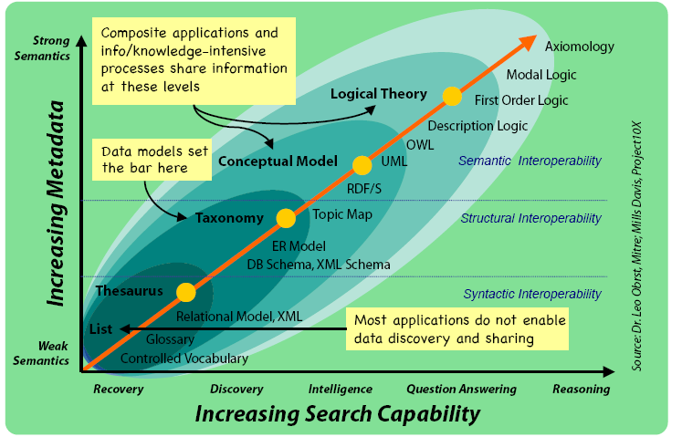
Ontology Spectrum
Improving Semantic Representation

Slide 20
Background: Improving Interoperability
Interoperability: “the capability of a system to automatically, without human intervention, provide services to and accept services from other systems, and to use the services so exchanged to enable the systems to work together to achieve a desired outcome” (Blais and Lacy 2004).
Academia and industry have laid out a path toward higher levels of interoperability: refer to the Levels of Conceptual Interoperability Model (LCIM) on the next slide (source: Tolk, Andreas, Saikou Y. Diallo, Charles D. Turnitsa, and Leslie S. Winters. 2006. “Composable M&S Web Services for Net-centric Applications.” Journal for Defense Modeling & Simulation (JDMS), 3:1:27-44. January.).
Objective is to achieve conceptual and pragmatic interoperability.

Slide 21
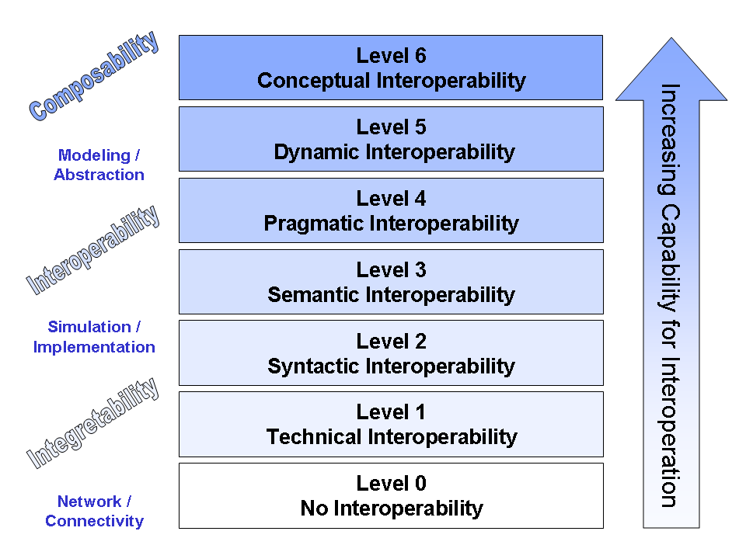
Levels of Conceptual Interoperability
Improving Interoperability: Levels of Conceptual Interoperability Model
Integratability

Slide 22
Background: Semantic Web
Architects of the World Wide Web have laid out a layered set of standards to achieve the Semantic Web vision: “not a separate Web but an extension of the current one, in which information is given well-defined meaning, better enabling computers and people to work in cooperation” (Berners-Lee et al. 2001)
Ultimate goal: achieve a scalable trusted information infrastructure where humans and software interact meaningfully, in a repeatable environment where expectations of quality and integrity are met.
Scalable approach indicates that single (ship + robot) solutions have potential to grow and encompass many simultaneous systems, thus improved data sharing, mission deconfliction, coordinated operations

Slide 23
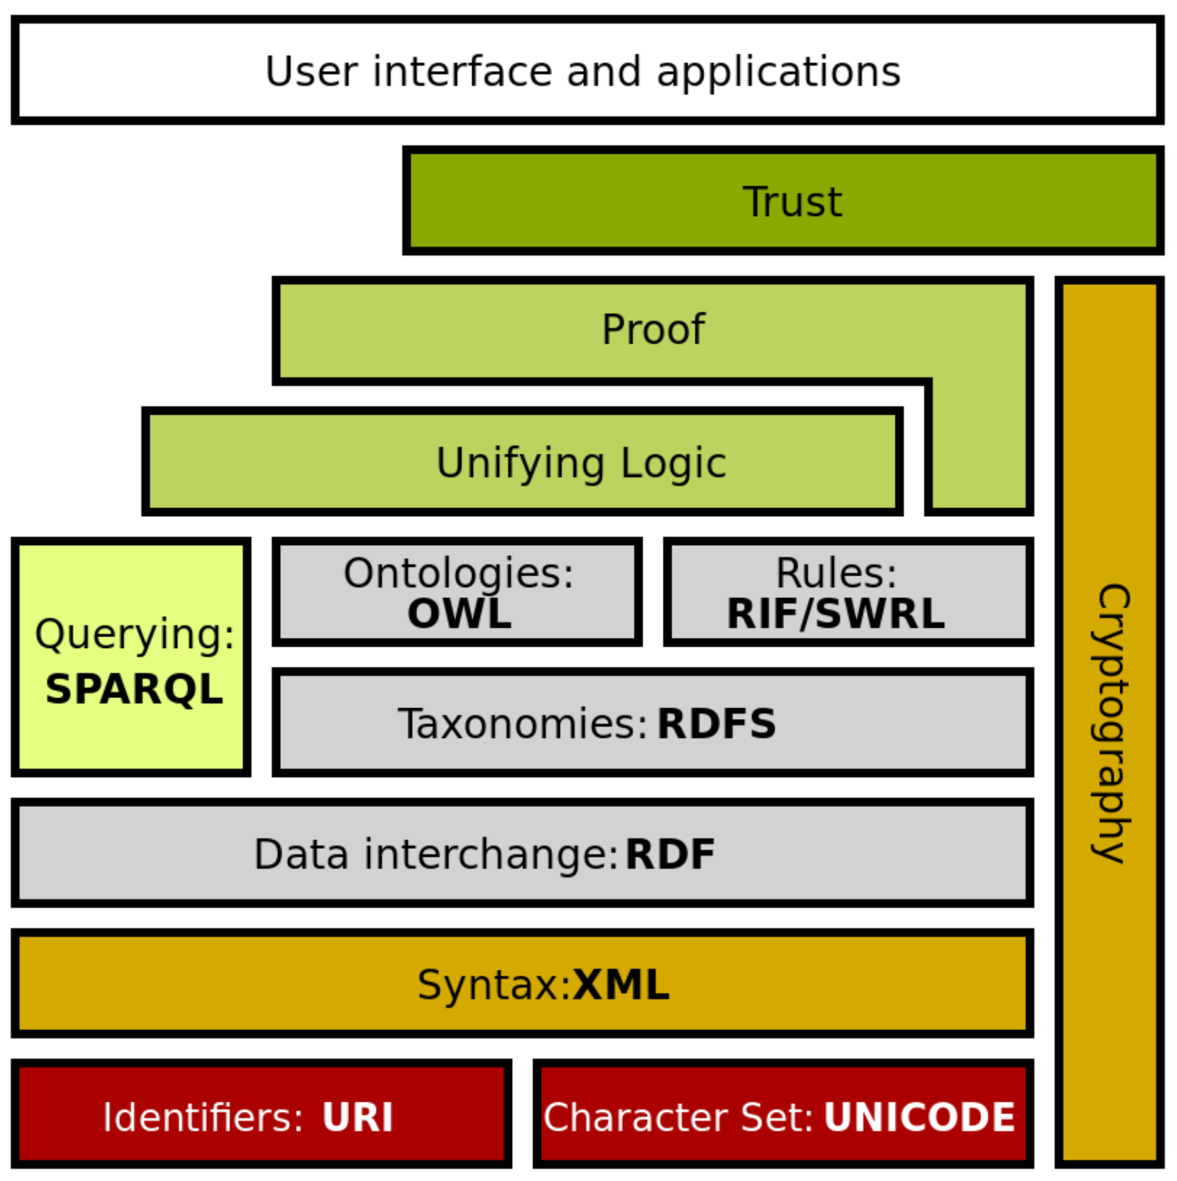
Semantic Web Stack
Extends larger Web architecture
All of these data languages are approved W3C standards
Proof and unifying logic are mathematically well defined
Trusting derived (composed) statements arises from
Encryption + digital signature confirms trusted data sources
Formal logic is basis for deriving new information
Wikipedia: Semantic Web Stack
Of note: this project is exercising every layer of Semantic Web stack.

Slide 24
Mission Execution Ontology (MEO) Development
Define MEO from concepts, properties, relationships using Protégé tool.
Create full set of canonical missions in AVCL (XML).
Determine exemplar mappings for AVCL primitives to Turtle for RDF/OWL.
Write conversion stylesheet AvclToMEO.xslt for full expressiveness.
Convert all AVCL missions to corresponding triples.
Confirm AVCL MEO, missions validate satisfactorily using Protégé, ARQ.
Automate build process as suite of repeatable unit-test queries (log).
Write SPARQL metaqueries to test, document MEO ontology relationships.
In progress: SPARQL queries to test AVCL mission representations in Turtle.

Slide 25
Mission Execution Ontology (MEO) for Ethical Control of Unmanned Systems in Surrogate Scenarios
Summary of relationships
Autonomous Vehicle Command Language (AVCL) for Missions.
Declarative XML, years of NPS research.
Multiple Mission Representations.
Imperative commands (orders/waypoints/etc.).
Declarative commands (mission goals).
Mission results (order log, telemetry etc.).
Mission metadata for parameters, settings.
Lisp and Prolog examples (Bob McGhee, NPS).
Autonomous Unmanned Vehicle (AUV) Workbench Simulation and Visualization Support
Recently restored, debug testing commenced.
AVCL 2.1 is prior published version, centered on syntactic validation, solo robot operations.
AVCL 3.0 is new working version for testing range of multi-participant missions.
Mission Execution Ontology (MEO) for Semantic Validation
Semantic Web framework of rules, relationships for ethical validation.
Initial examples in IEEE JOE paper.
Retested using current Protégé, Jena tools.
Sailor Overboard and Other Missions
Hand-crafted triples using Turtle syntax.
Beginning to build unit testing framework.
Confirming correlation of AVCL information model to existing MEO ontology.
Automatic conversion of AVCL missions to match, thus accelerating multiple-mission testing on diverse systems.
Visualization, reporting via AUV Workbench can aid understanding, mission planning and further progress.

Slide 26
Unmanned Vehicle Mission Execution Ontology (MEO)
Concepts
Roles
Mission
Dashes indicate roles or concepts defined in terms of other roles or concepts
has_constraint
applies_to
can_perform
performable_by
starts_with
includes
is_next
Constraint
applies_to
Goal
has_capability
Vehicle
end_state
follows
can_identify
has_feature
End_ Condition
requires
meets_requirement
Goal_ Requirement
can_fulfill
Vehicle_ Feature
can_test
Original design
15 October 2014

Slide 27
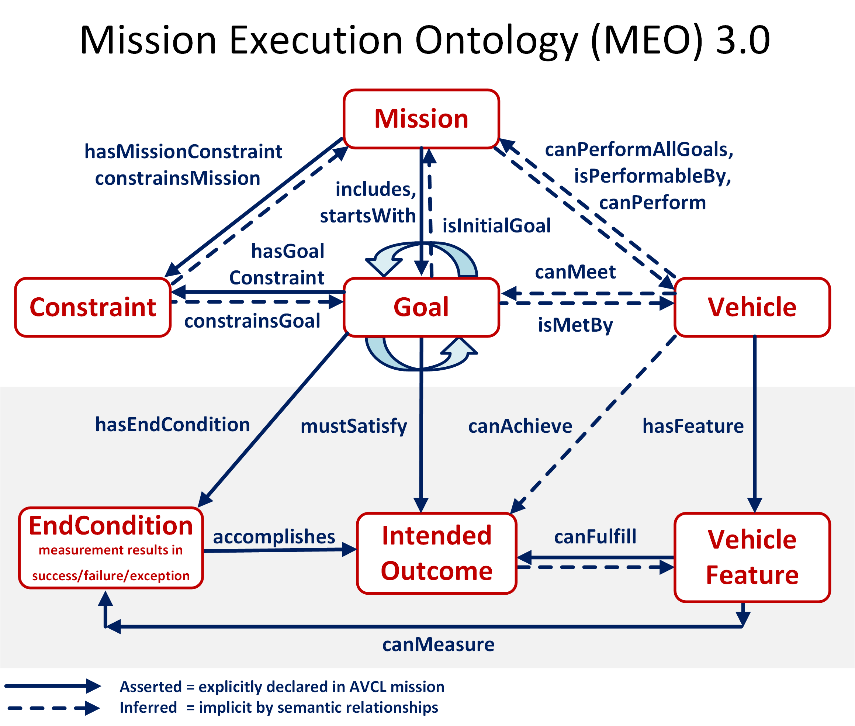

Slide 28
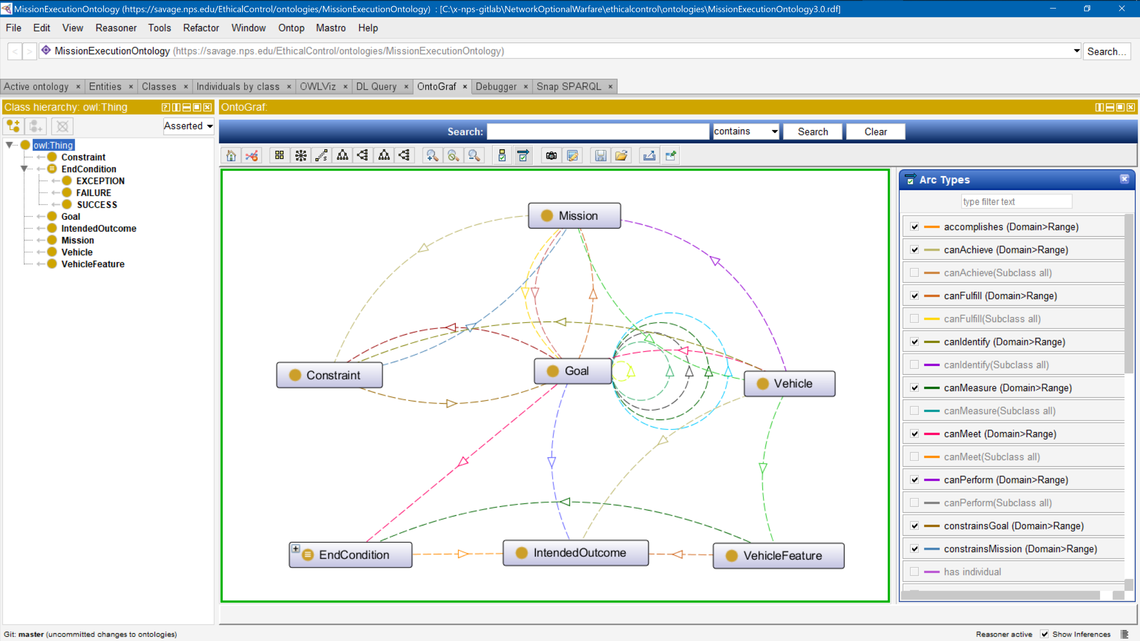
Mission Execution Ontology (MEO) source implemented, tested using Protégé tool

Slide 29
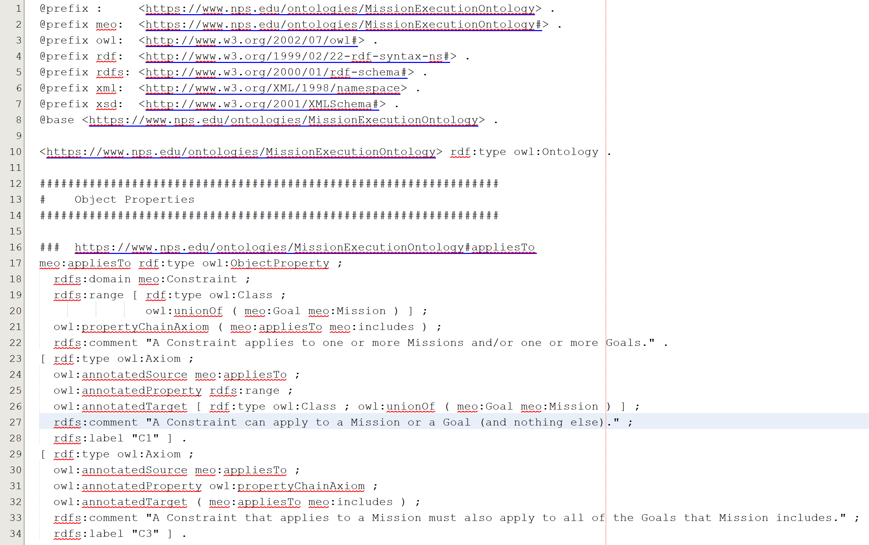
Mission Execution Ontology (MEO) source implemented, tested using Protégé tool
Turtle (.ttl) syntax

Slide 30
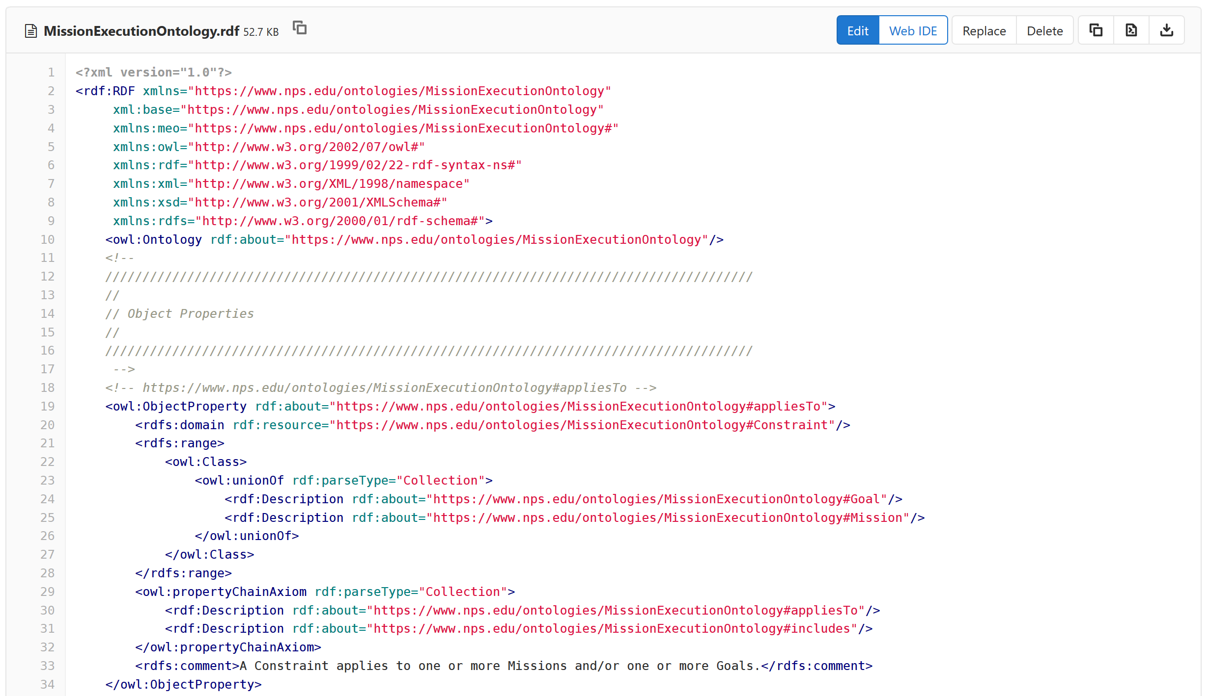
Mission Execution Ontology (MEO) source implemented, tested using Protégé tool
RDF (XML) syntax

Slide 31
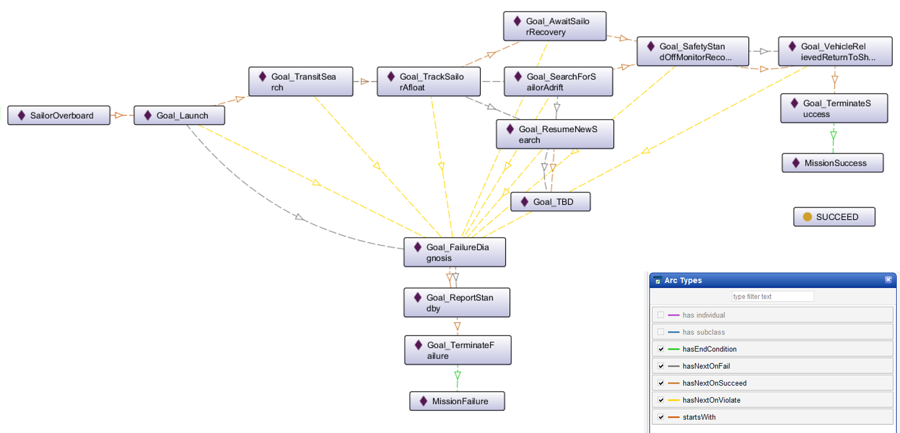
Ethical Control of Unmanned Systems in a Surrogate Scenario: Sailor Overboard Mission defined using the MEO Ontology
Current work is designing,
building and testing a set
of exemplar missions

Slide 32
Ethical Control Mission Design
Life-saving missions and missions with lethal force are complementary. Human-robot activity can result in lethal or life-saving outcomes.
Continuing refinement and clarity are opening the path to repeatability. OODA Loop compatibility ensures harmonization with human operations.

Slide 33
Core Considerations for Artificial Intelligence (AI)
Effective AI turns data into information for use by humans.
AI systems do not have capacity for rational thought or morality.
Unmanned systems require sophisticated control across time, space.
A large and involved body of internationally accepted law comprises Law of Armed Conflict (LOAC), bounding Rules of Engagement (ROE).
Only professional warfighters have moral capacity, legal culpability, and societal authority to direct actions applying lethal force.
Humans must be able to trust that systems under their direction will do what they are told to do, and not do what they are forbidden to do.
Successful Ethical Control of unmanned systems must be testable.

Slide 34
Not suitable for brute-force numerical computation
AI algorithms for Machine Learning (ML) and Data Mining are often based on statistically training against large datasets to find patterns for filters.
For example, convolutional neural networks, genetic algorithms, reinforcement learning, etc.
Often requires identifying right/wrong matches within large search spaces.
Such predictive analytics are useful for classification models using detailed and noisy sensor data. Given the central importance of IFFNU and some conditional communications to ethical control, ML filters can be helpful if carefully applied.
Nevertheless such approaches are not appropriate for carefully following Rules of Engagement (ROEs), Laws of Armed Conflict (LOAC) or other ethical prerequisites, especially when human expertise and judgement is essential for robot teams.
(Similarly, massive computation or Quantum Computing approaches might be useful in some problems, but are not of practical use for Ethical Control mission orders given by human commanders judiciously guiding remote mobile robots)
Naval history has long shown that sound human judgement is crucial for assessing best strategies and courses of action in ill-structured contexts. Semantic Web approaches are preferable and actionable for Ethical Control.

Slide 35
Mission clarity for humans – and robots
Simplicity of success, failure, and (rare) exception outcomes encourages well-defined tasks and unambiguous, measurable criteria for continuation.
Confirmable beforehand: can a tactical officer (or commanding officer) review such a mission and then confidently say
“yes I understand and approve this human-robot mission” or, equivalently,
“yes I understand this mission and my team can carry it out themselves.”
Converse:
if an officer can’t fully review/understand/approve such a mission, then likely it is ill-defined and needs further clarification anyway.
Added benefit: missions that are clearly readable/runnable by humans and robots can be further composed and checked by C2 planning tools to test for group operational-space management, avoiding mutual interference, etc.

Slide 36
Wrong question, right question
Wrong question to ask first when planning a tactical operation:
“What are my robots doing out there?”
Right question to ask first when planning a tactical operation:
“What is my human-robot team doing out there?”
Human-robot team mission has to be understood first!
Robots complement humans, who must remain in charge throughout.
If you don’t have an OODA loop, you don’t have a competent plan.

Slide 37
Observe Orient Decide Act (OODA) Loop
“The OODA loop is the cycle observe–orient–decide–act, developed by military strategist and USAF Colonel John Boyd. Boyd applied the concept to the combat operations process, often at the operational level during military campaigns. It is now also often applied to understand commercial operations and learning processes. The approach explains how agility can overcome raw power in dealing with human opponents.” – Wikipedia
All effective purposeful military activity can be conceived in terms of OODA loop feedback process, especially at tactical/operational levels.
Aligning Ethical Control mission design with OODA loop ensures that unmanned systems understandably partner within human-run teams.

Slide 38
OODA Significance for Ethical Control
Classical robotic Sense-Decide-Act cycle for closed-loop control is insufficient for proper delegation of lethal (or lifesaving) force to unmanned systems.
Observe-Orient-Decide-Act (OODA) Loop is essential for coherent operations.
Observe includes direct sensing and communication inputs.
Orientation includes thorough Rules of Engagement (ROE) constraints and identification friend/foe/neutral/unknown (IFFNU) of all relevant contacts.
Decision logic of unmanned system tactics, techniques, procedures (TTP) includes authorization and confirmation by human supervisors, either in real-time or in advance, for critical steps leading to lethal force.
Actions in tandem with direct or intermittent human supervisory command enables effective Ethical Control of remote systems.
Feedback loops are essential, generally leading to… more effective operations.

Slide 39
OODA Clarity for Mission Definitions
Robot activity must complement, not contradict, human OODA loop.
Application of ROE and LOAC requirements can be confirmed present as part of mission definition, typically as
Goal success/failure criteria, preset authorities or time-outs for delegation, and
Constraints on conduct (safe zones, permission periods/requirements, etc.)
When human leaders confirm correct inclusion of ROE requirements in mission orders, they essentially perform an audit of doctrine and TTPs.
Similar audit confirmation can be applied to well-structured orders:
Autonomous Vehicle Command Language (AVCL) expresses well-defined goals,
Mission Execution Ontology (MEO) defines relationships and requirements,
SPARQL queries can be written to perform such logical-confirmation checks.
Resulting mission orders are thus coherent from OODA perspective.

Slide 40
Canonical Ethical Mission Development 1
Progressive sophistication to test and evaluate Ethical Control design.
Sailor Overboard for life-saving force under close coordination,
Lifeboat Tracking for life-saving force under remote conditions,
Pirate Boats Seizing Merchant for steady escalation to lethal force,
Robot Swarm Attacks Hospital Ship to prevent hostile provocation of sense-decide-act vulnerabilities through Ethical Control safeguards. Two variants show fundamental importance of ethical constraints.
Demonstrating a range of functionality tests majority of Ethical Control capabilities that are currently envisioned. These canonical capabilities also “set the stage” for further work on advanced problems of interest.

Slide 41
OODA Loops for Ethical Control Canonical Missions
Ethical Control OODA Loops | Observe | Orient | Decide | Act
Sailor Overboard | Find Sailor | Report status | Avoid interference | Track sailor until rescued or relieved
Lifeboat Rescue | Find Lifeboat | Report status | Two-way communication | Track life raft until relieved
Pirate Seizure of Merchant Ship | Find merchant ship, pirate small boats | Identity Friend Foe Neutral Unknown (IFFNU) Issue warnings | Human commander authorization to use lethal force | Attack to defend ship if provoked, stay with merchant
Hospital Ship Swarm Attack | EM threat signals detected | (no orientation step in Sense Decide Act) | Reflex-response weapons attack | Mistaken attack on friendly = war crime
Hospital Ship Defense detects spoofing anti-pattern | EM threat signals detected | IFFNU including correlation | Human requirement for lethal force unmet, attack avoided | Report threat alert, commence search for hostile actors

Slide 42
Canonical Ethical Mission Development 2
Next steps: completing this initial set of missions is expected to
Demonstrate both logical soundness and human comprehensibility of Ethical Control methodology, for both life-saving and lethal force.
“Tune up” AVCL vocabulary for mission orders, revealing good practices and repeatable design patterns for common activities in diverse missions.
Translation of AVCL missions into corresponding MEO representations to allow deeper semantic validation of correctness of ethical constraints.
Performing AVCL missions in AUV Workbench tool is expected to show mission execution working in simulation, or else reveal hidden flaws.
Future work: prepare for comprehensive testing of unmanned systems across range of requirements necessary for afloat operational qualification.

Slide 43
Tactical span of control for ship with many robots
Span of control is number of subordinates reporting to a supervisor.
Classic definition from business management, also applies to leadership.
In effect, multiple offboard unmanned systems supervised by a ship comprise its span of control across the tactical battlespace.
Greater tactical presence across distances of time and space means ship commanders have greater ability to influence their local theater.
Clear mission guidance on human-checkpoint requirements reduces dependency on communication links (i.e. Network Optional Warfare).
Next diagram illustrates how such increased ability to project power enables ship to maintain chosen standoff location while nevertheless focusing direct attention and actions in multiple locations at once.

Slide 44
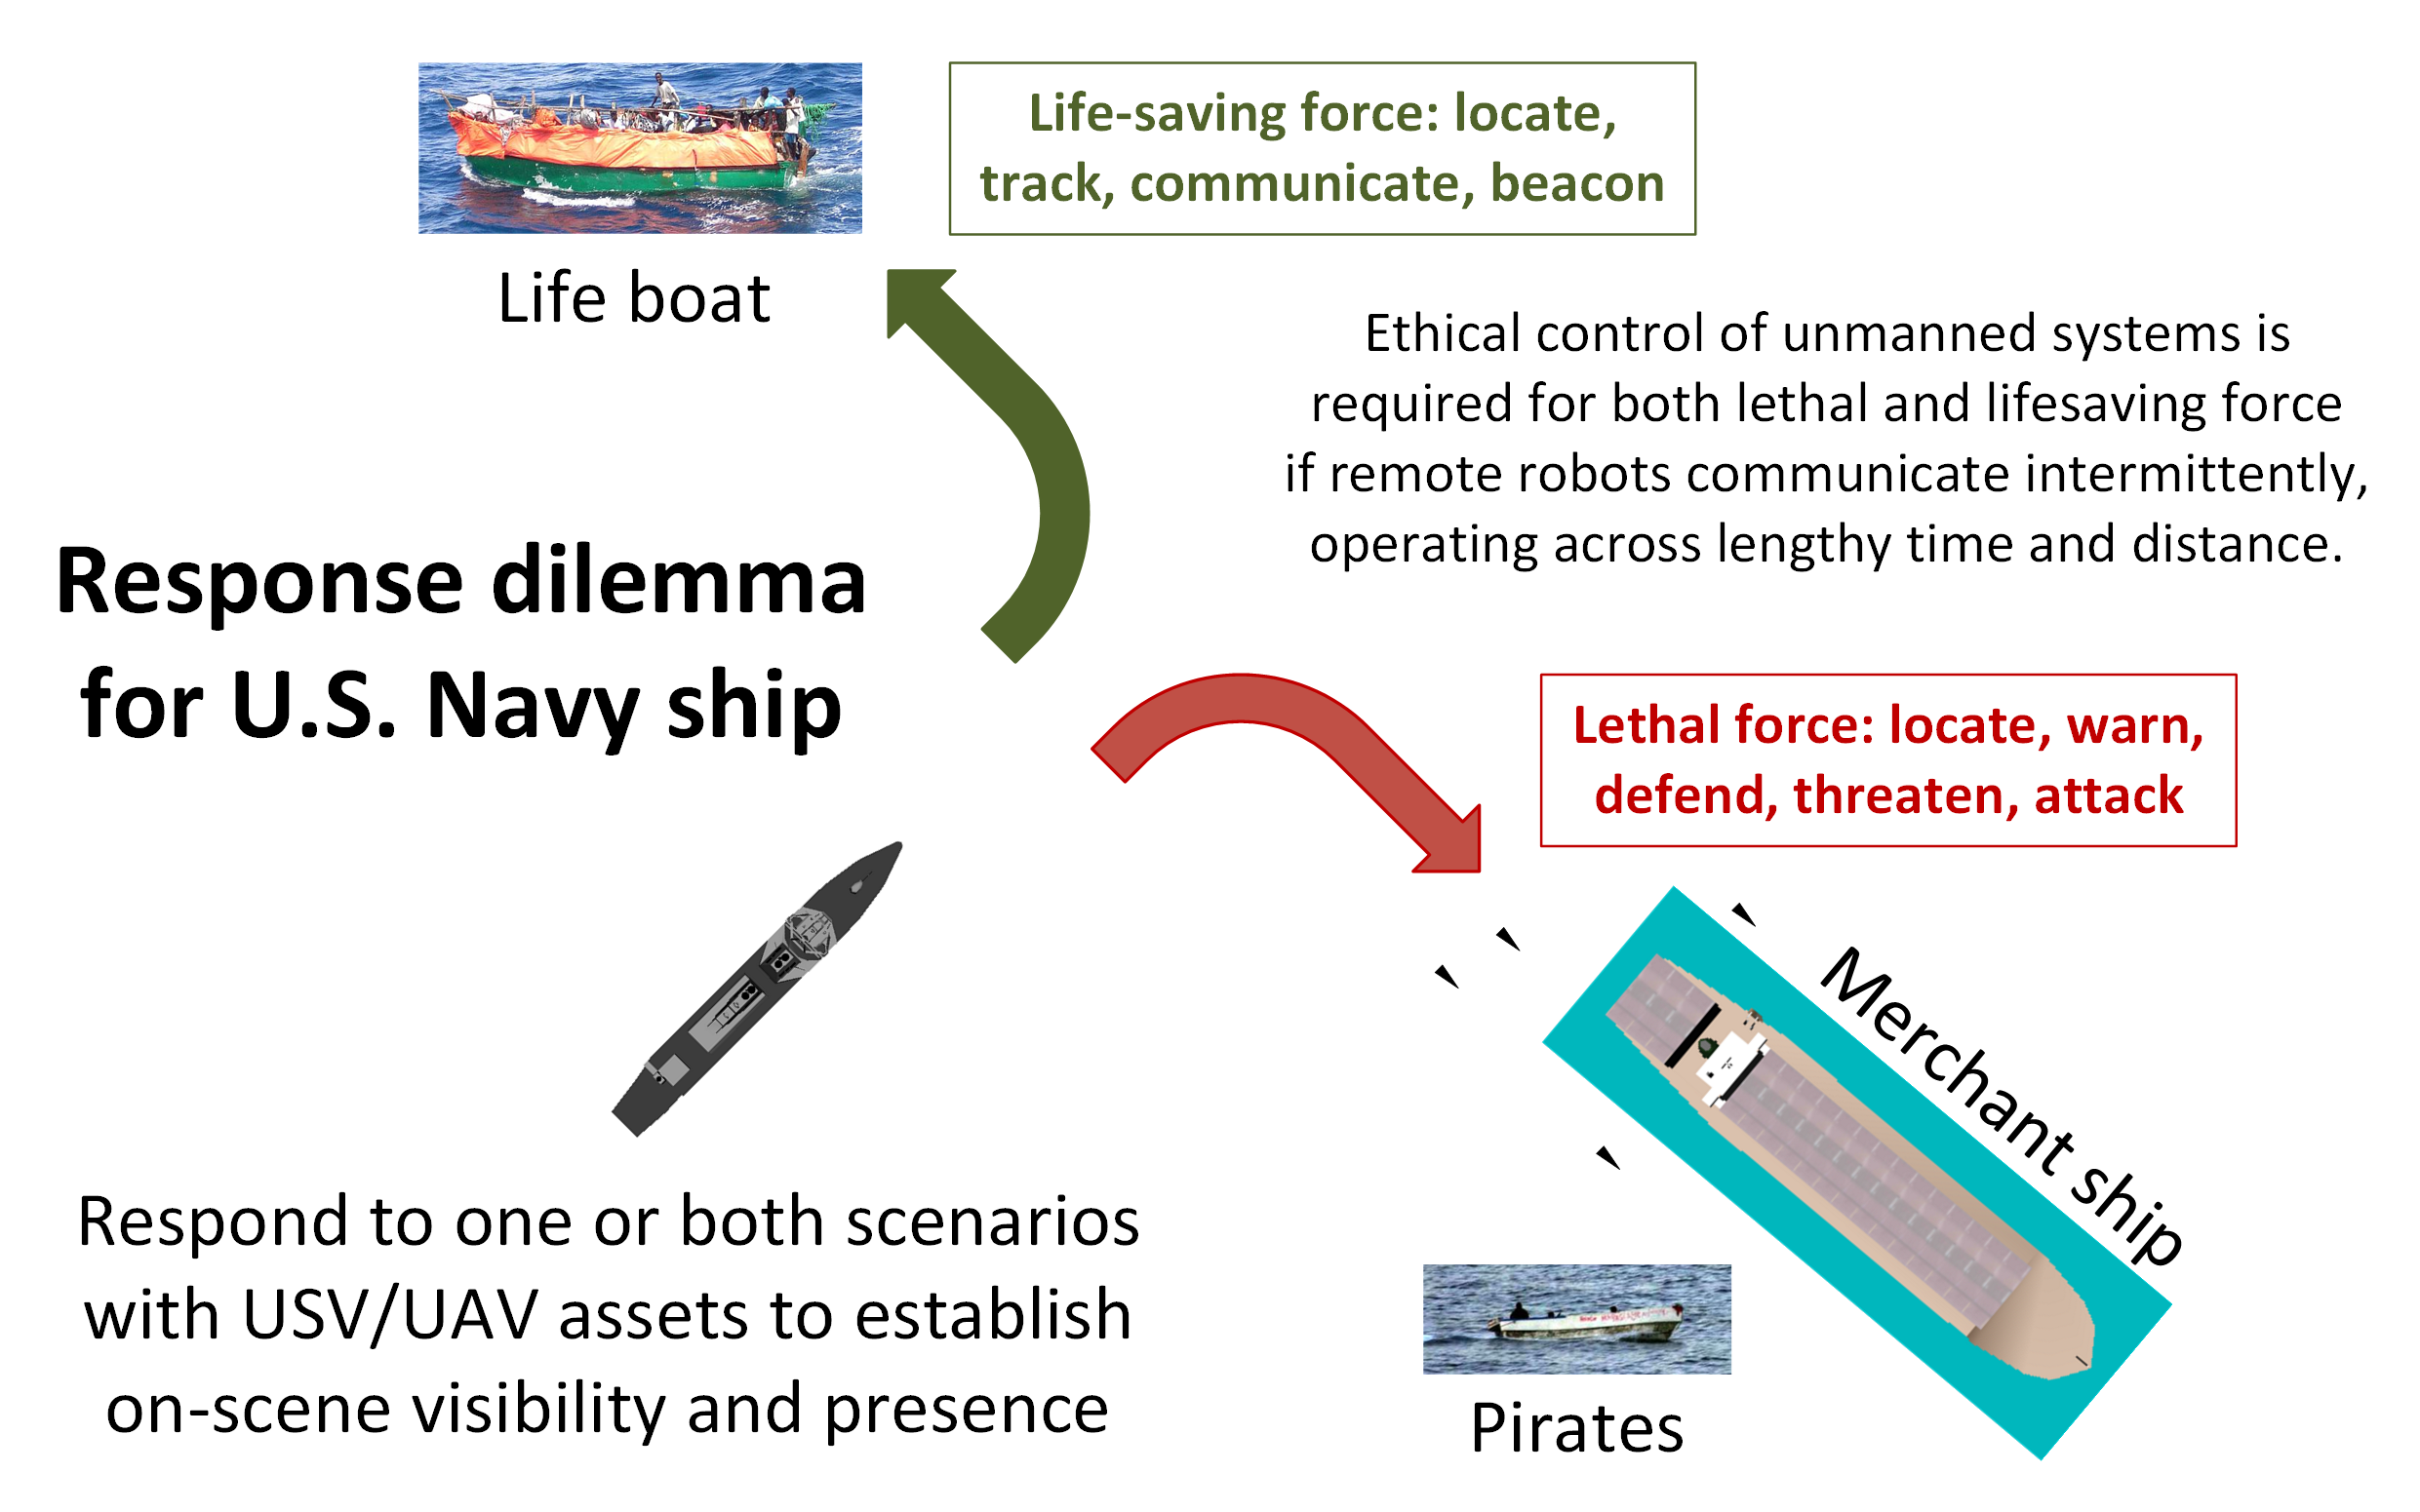
Ship response dilemma

Slide 45
Exemplar Missions
Unmanned systems working in tandem with human forces, authorized by commander for life-saving or lethal force, can handle progressive challenges in distance and time.
Notes:
The following missions carefully define and test such capabilities.

Slide 46
Catalog of Exemplar Missions
Structure for each section
Design and Description
Mission decision-flow diagram
AVCL implementation source: version control, XML Spy table
Semantic Web Mission MEO .ttl Turtle representation
SPARQL semantic queries
Lisp and Prolog autocode
AUVW simulation
Sailor Overboard
Lifeboat Tracking
Pirates Seizing Merchant Ship
Hospital Ship EM Decoy Scenario compares Sense-Decide-Act vs. Observe-Orient-Decide-Act (OODA)

Slide 47
Sailor Overboard Mission: Design
Motivations
Explore how life-saving force is complementary to lethal force, with many similar considerations for remote supervision.
First demonstrate human-system teaming in close proximity to ship, where direct override of robot control by human operator is possible.
No temporal delays, all actions and reactions must be immediate.
Show that mission design can complement shipboard procedures.
Lessons learned
Good design patterns to visually represent AVCL mission satisfactorily.
Temporal flow (left to right, e.g. Gantt chart) best suited for diagram.

Slide 48
Sailor Overboard Mission: Description
Purpose
Life saving: single unmanned air/surface vehicle actions to complement human responses when performing “SAILOR OVERBOARD” operations.
Carried out in direct concert with formal shipboard emergency procedures.
Multiple UAVs/USVs might be employed in parallel with ships and aircraft, avoid mutual interference by each following deconflicted mission orders.
Phases
Deploy/Launch, Rendezvous, Track Sailor until Safe, Return/Recovery.
Human Supervisory Role
Order standoff if interfering, manual control is possible due to proximity, can communicate to sailor via loudspeaker or beacon light.

Slide 49
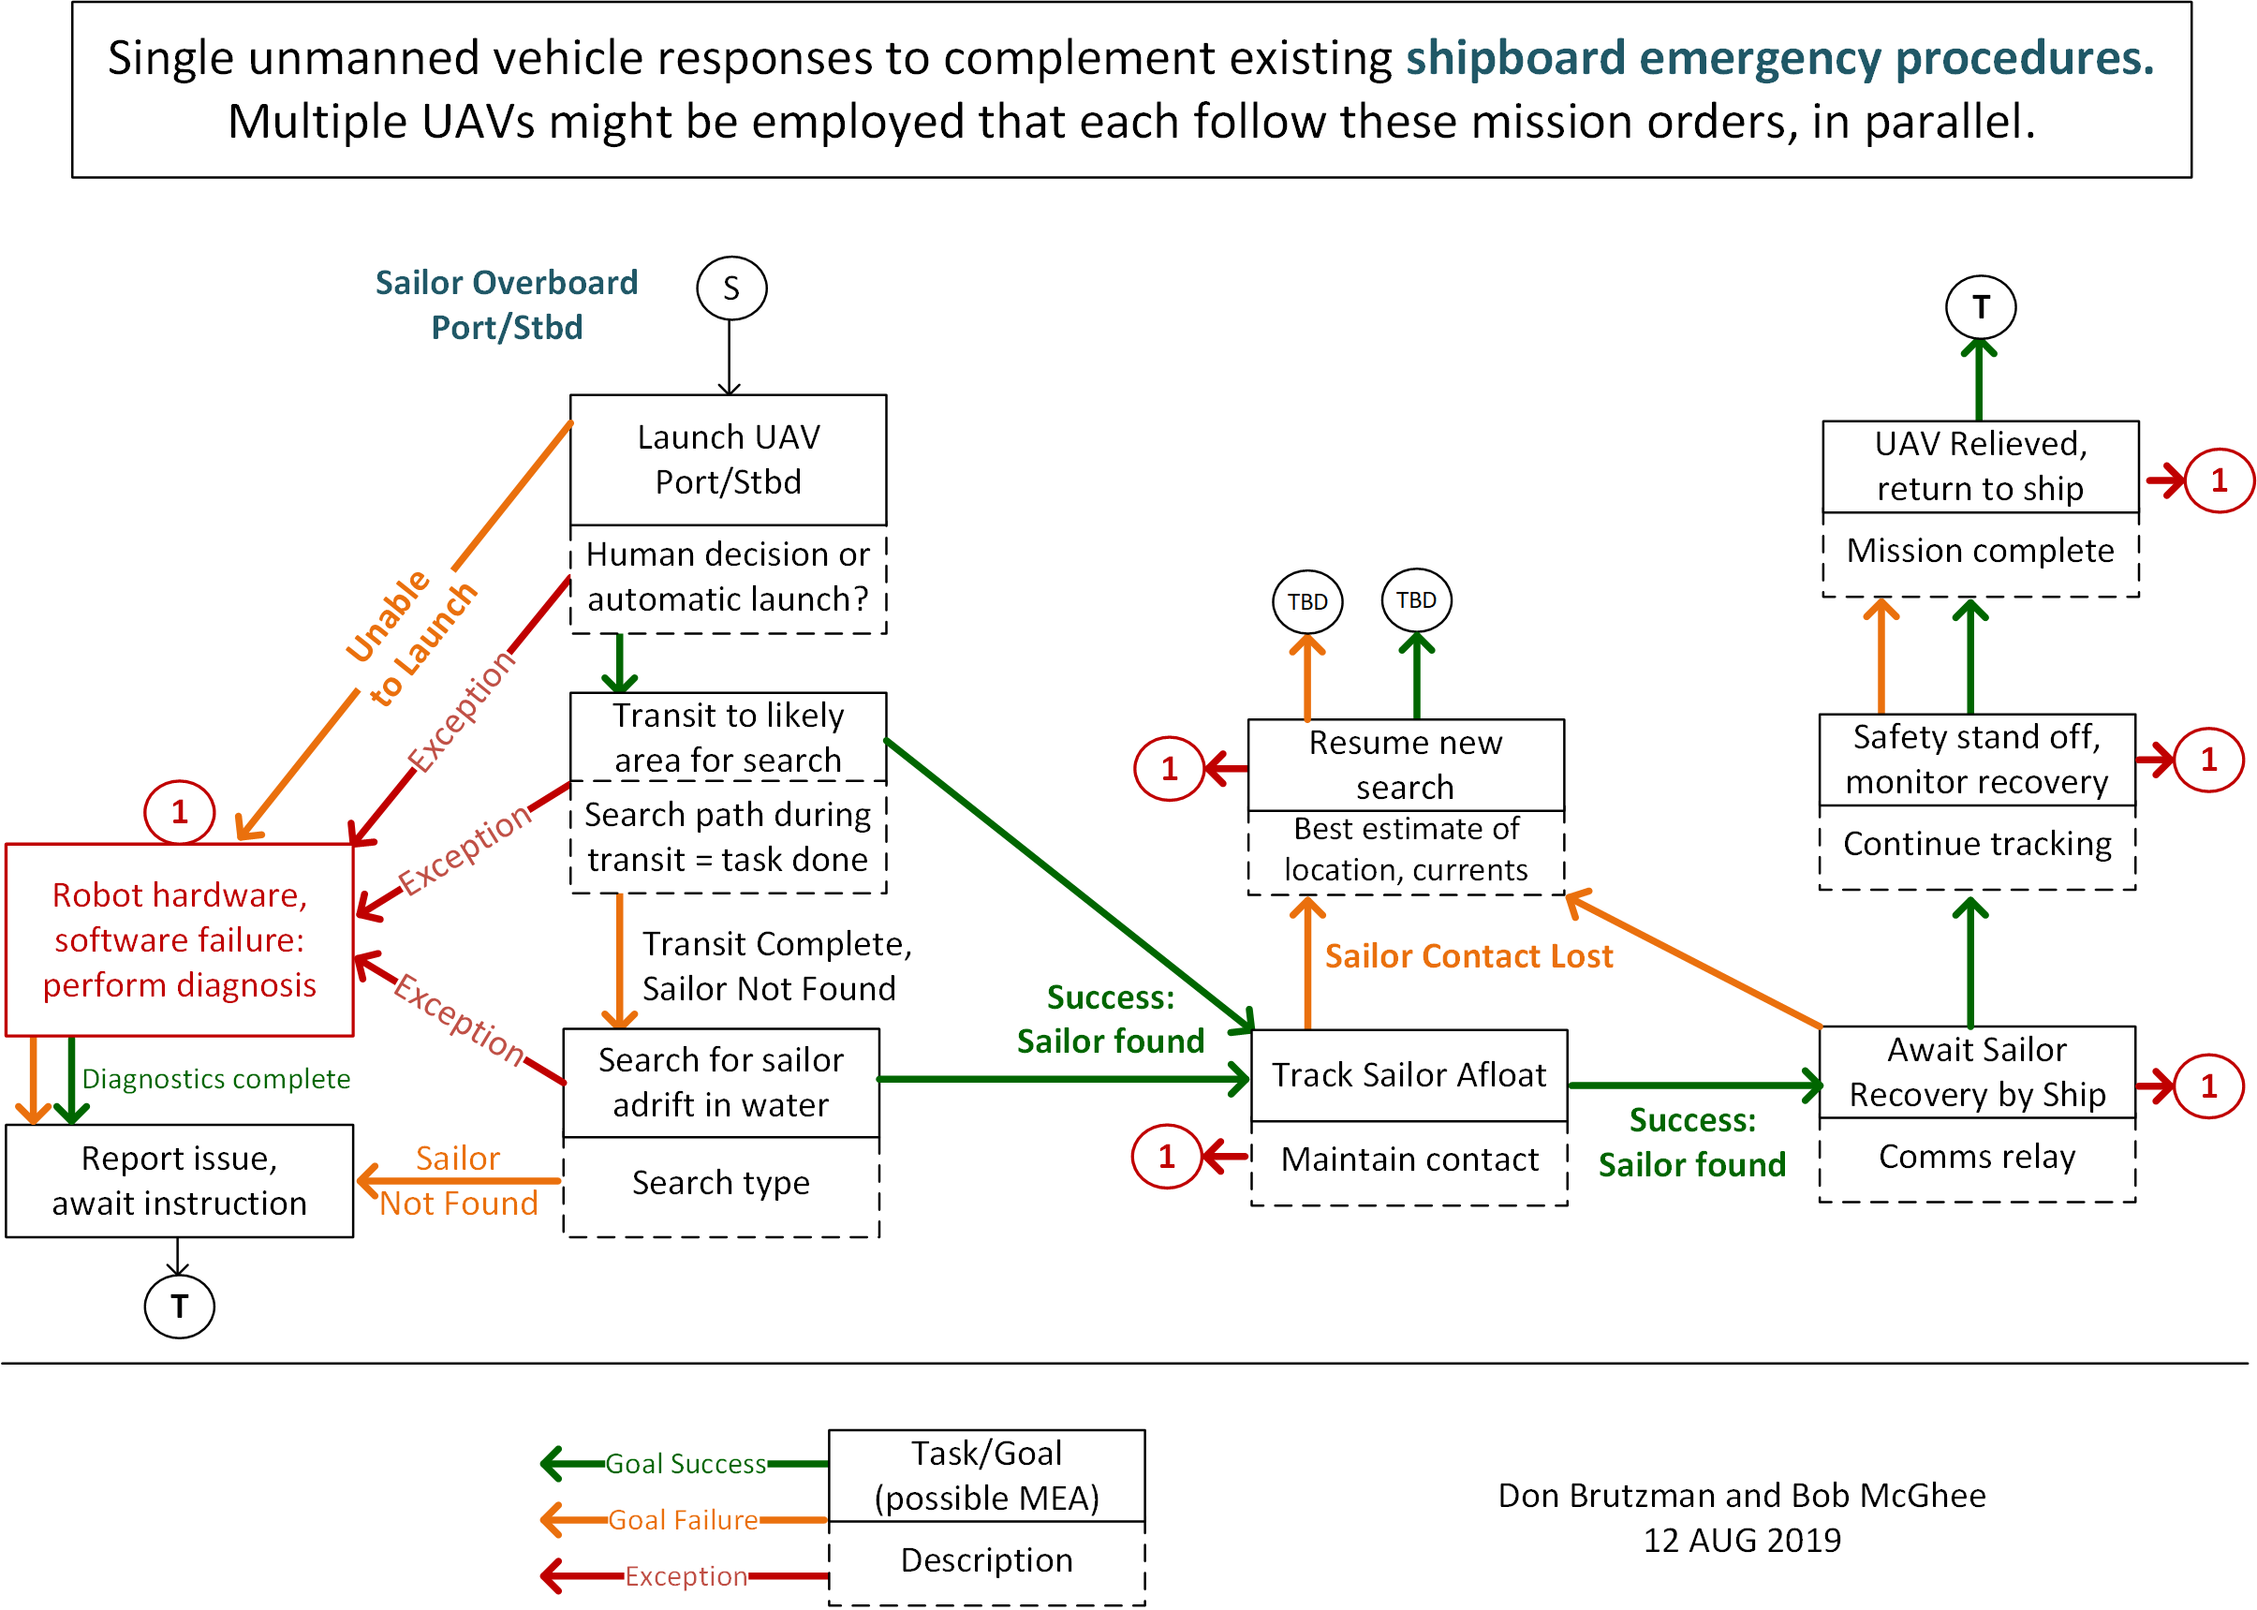
Sailor overboard, original diagram
Original Version

Slide 50
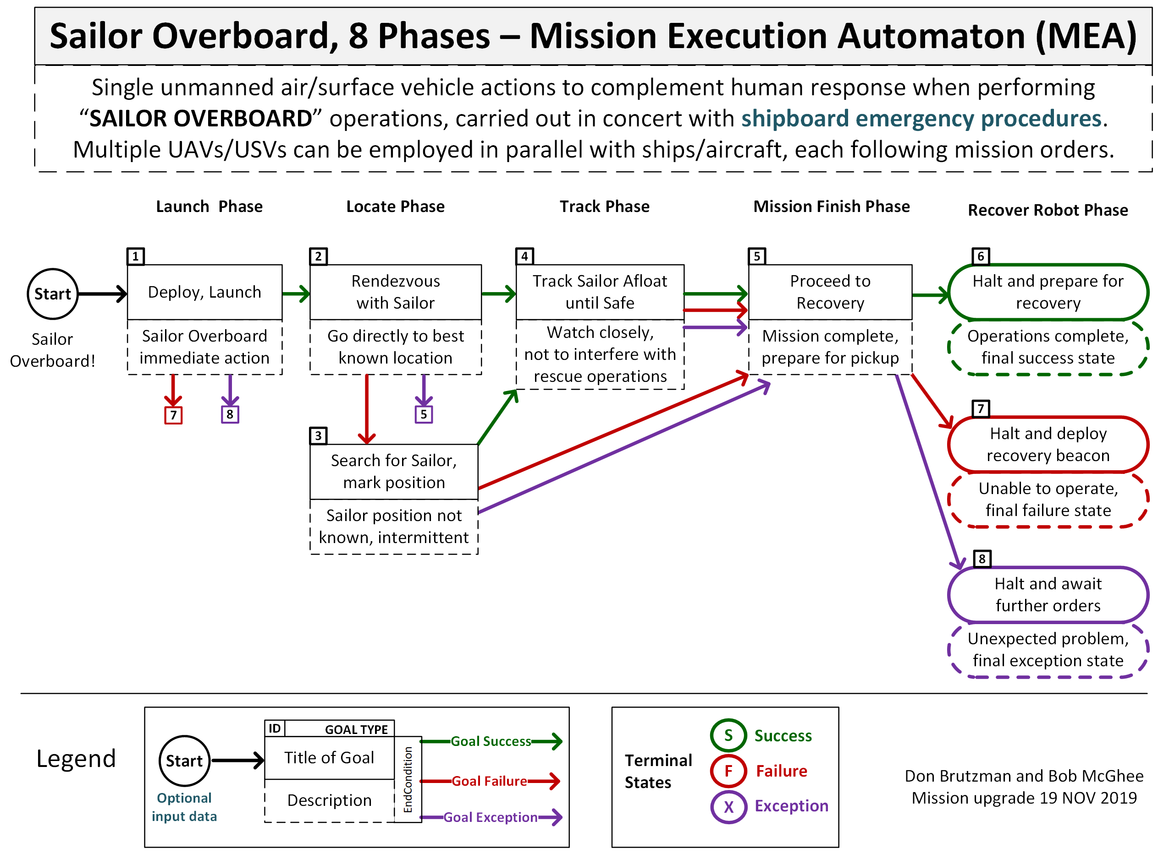
Sailor overboard mission diagram

Slide 51
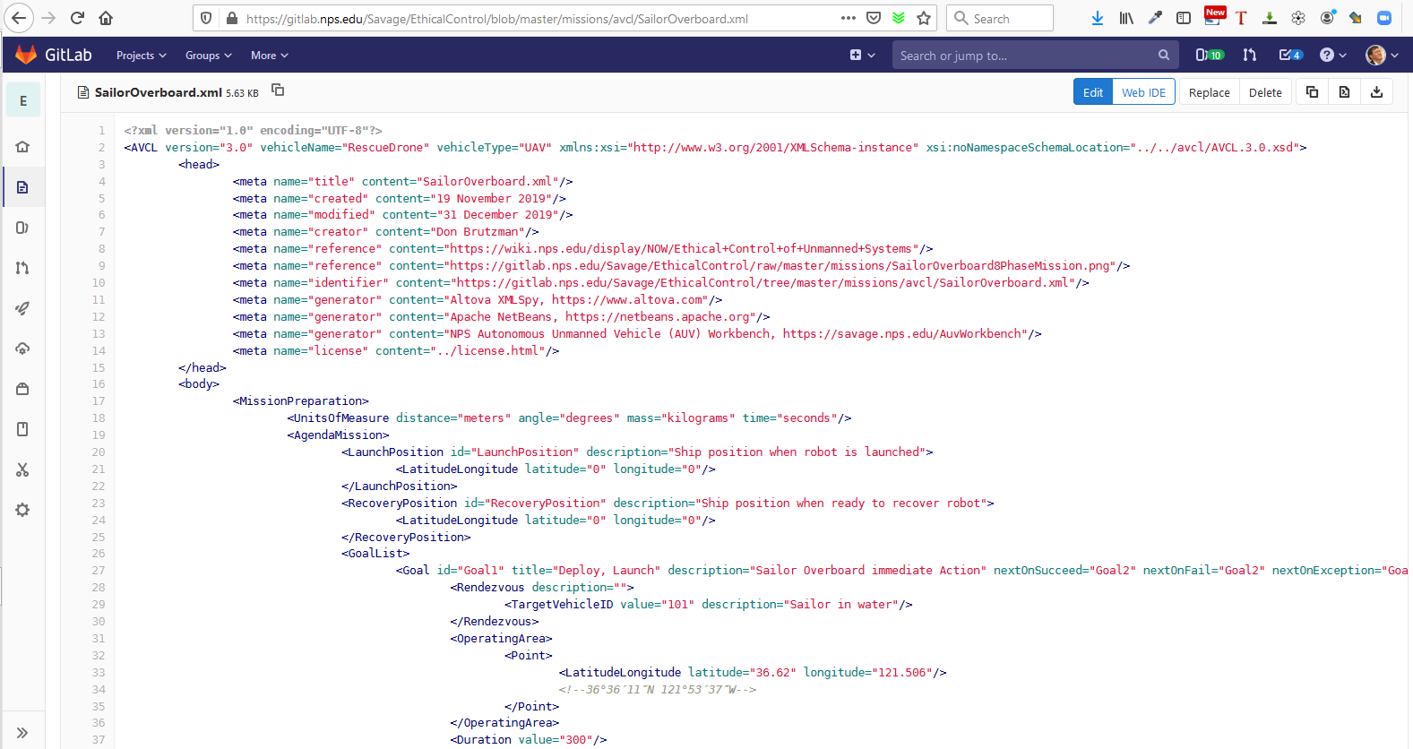
SailorOverboard.xml in gitlab.nps.edu version control

Slide 52
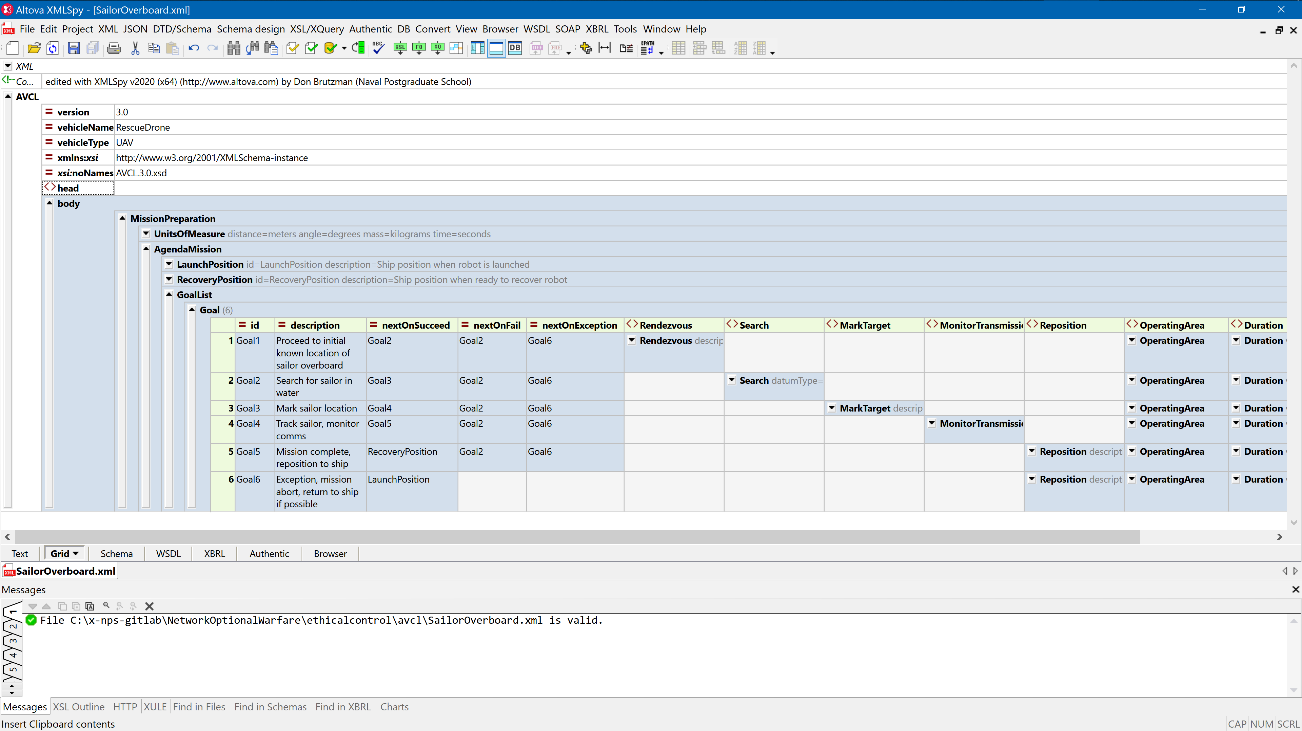
Sailor overboard mission orders AVCL

Slide 53
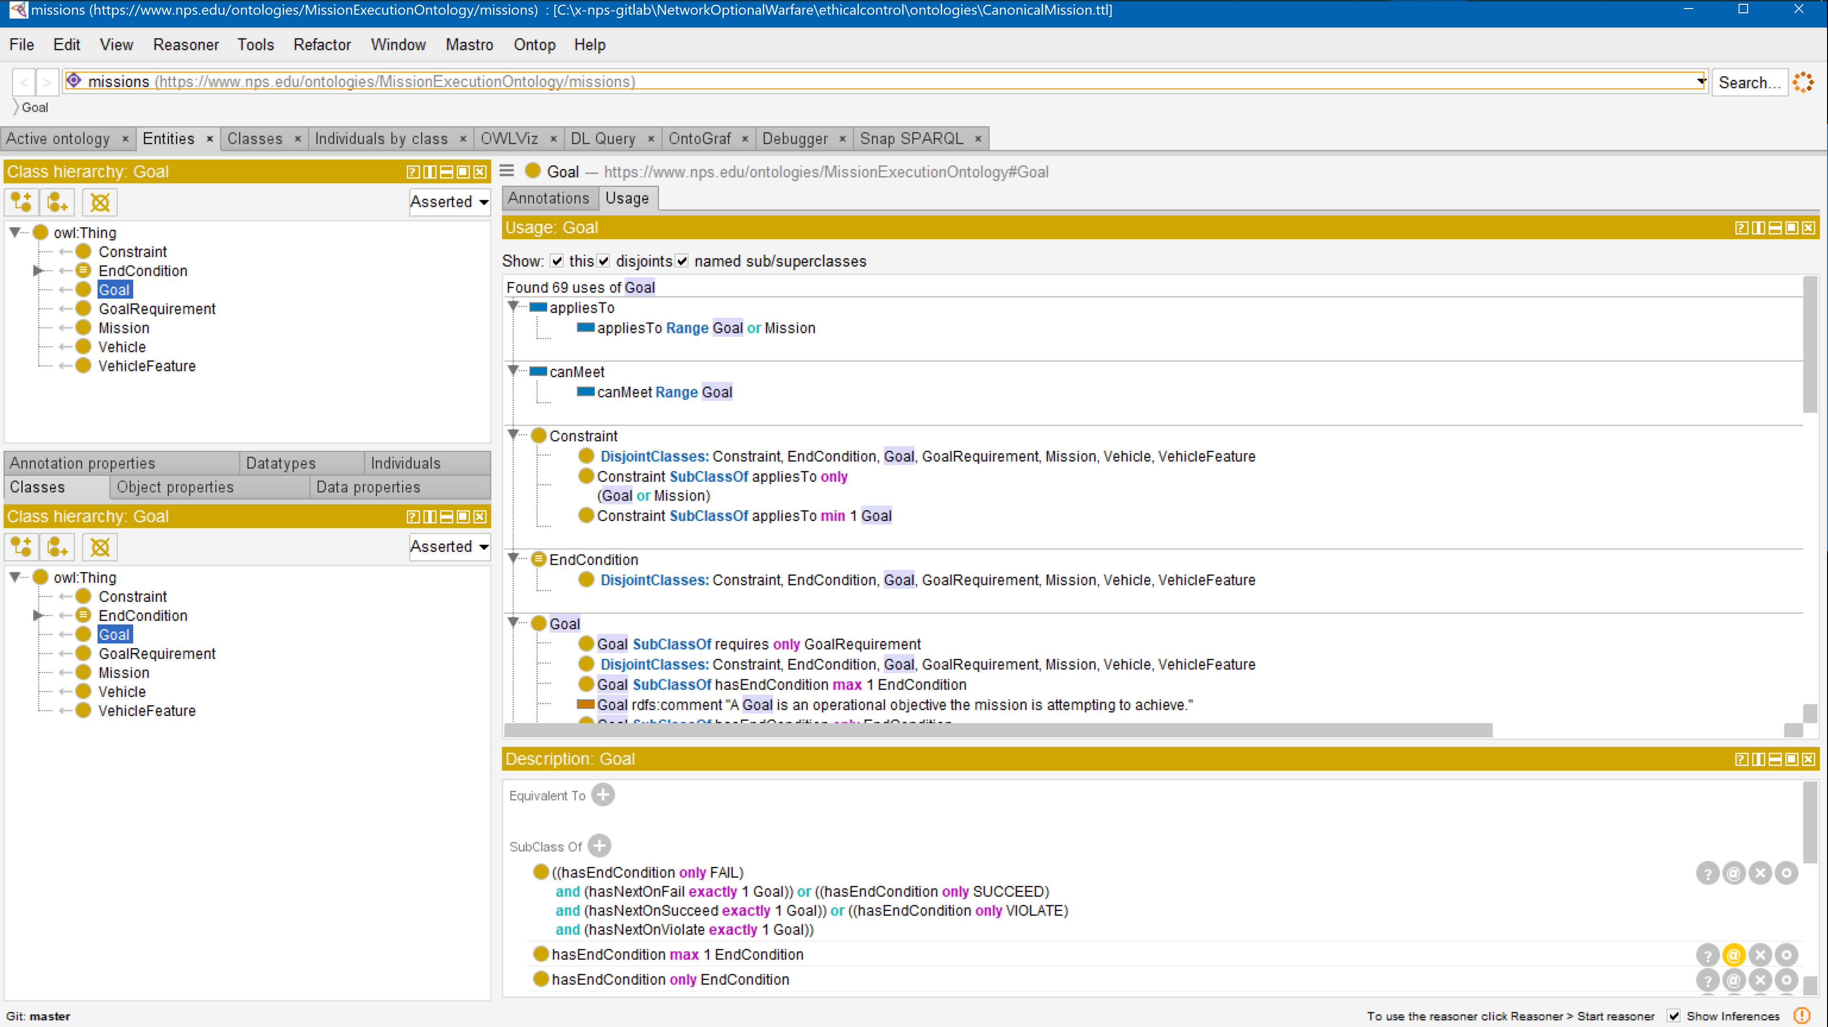
Sailor overboard mission .ttl Turtle

Slide 54
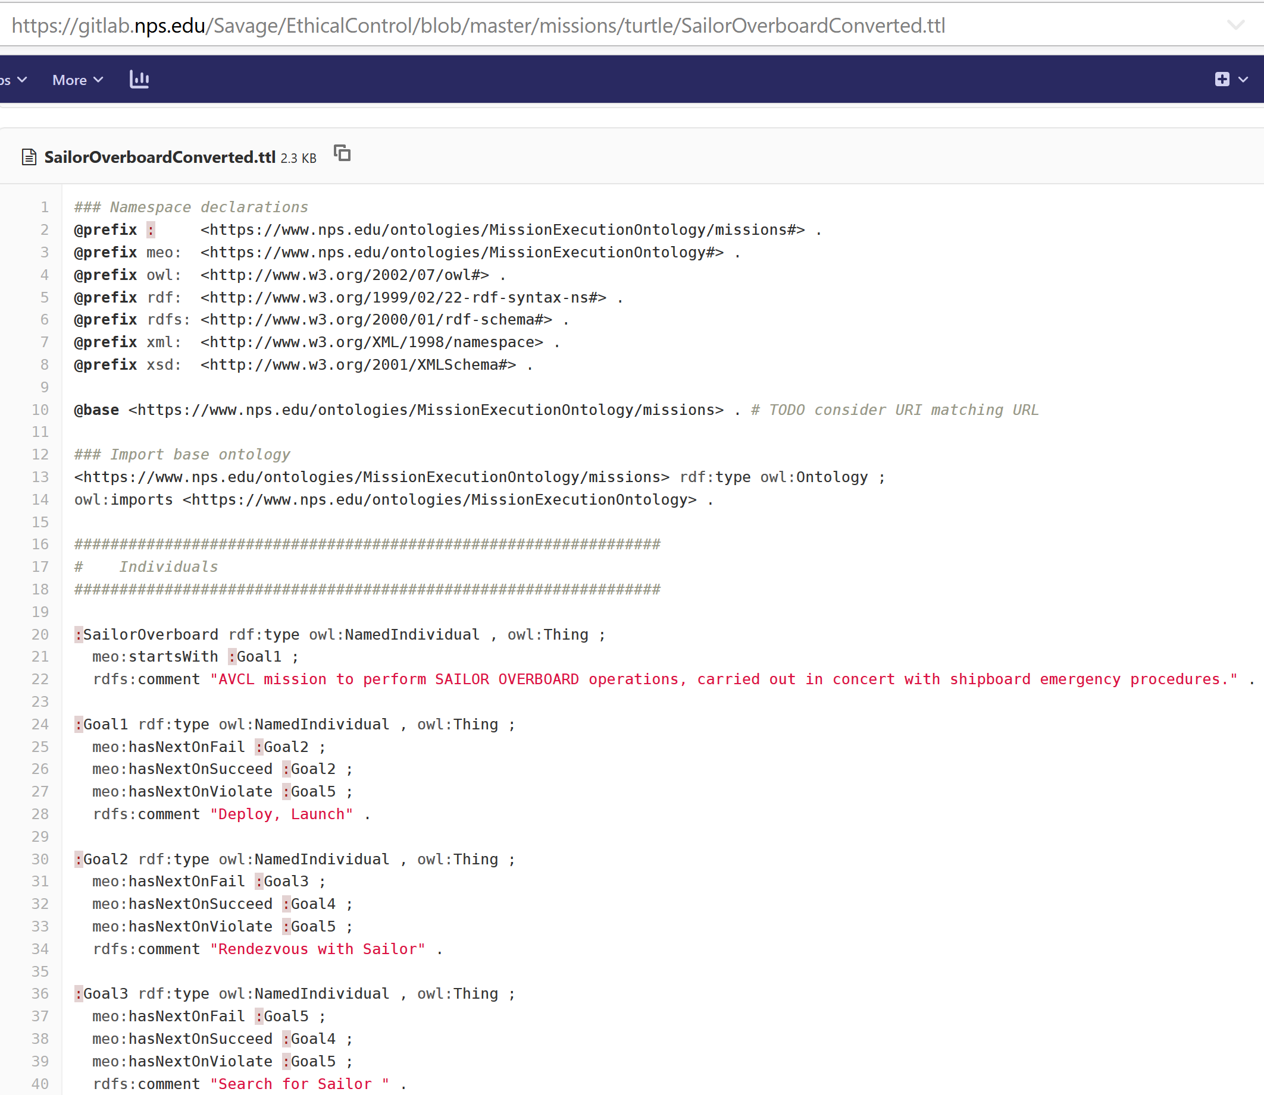
SailorOverboardConverted.ttl Turtle excerpt autogenerated in gitlab.nps.edu version control

Slide 55
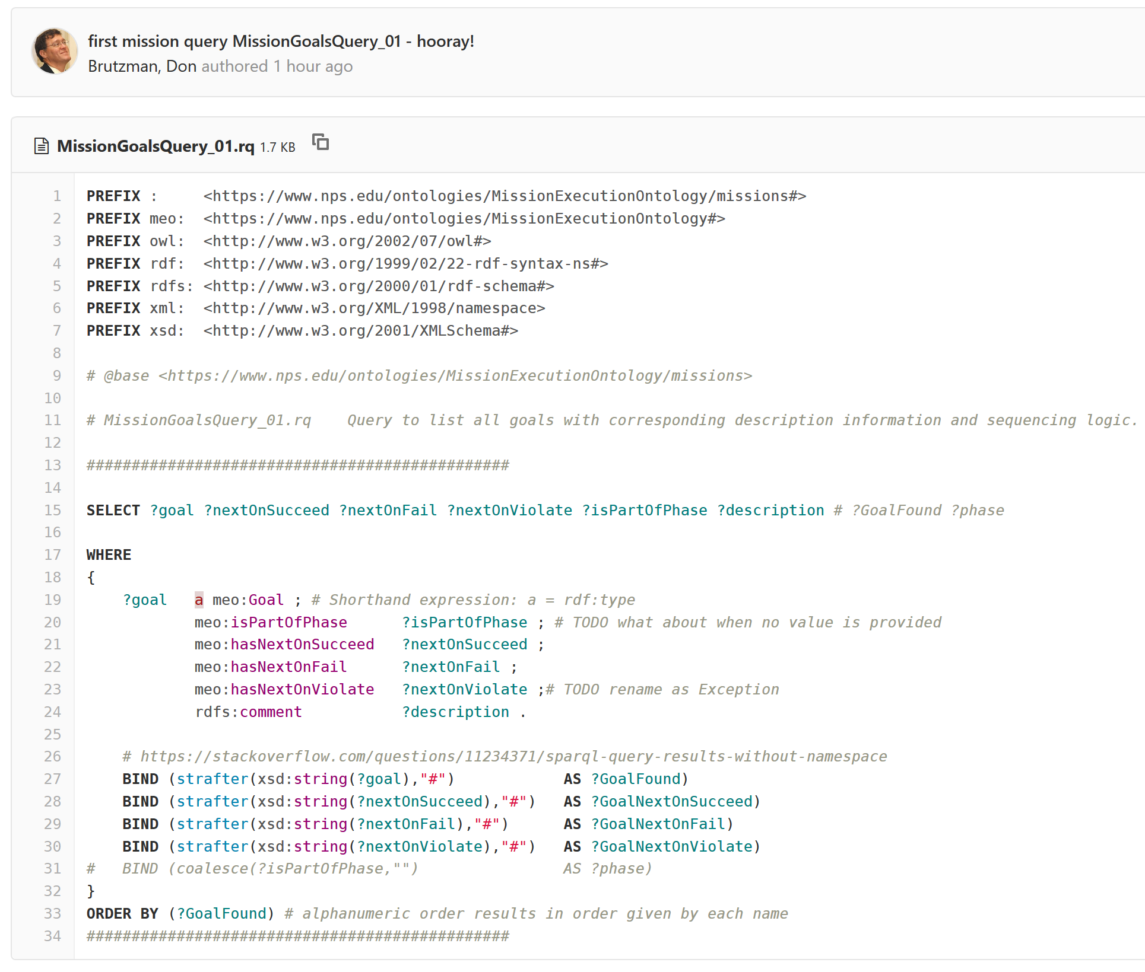
SPARQL mission query MissionQuery_01_GoalBranches.rq

Slide 56
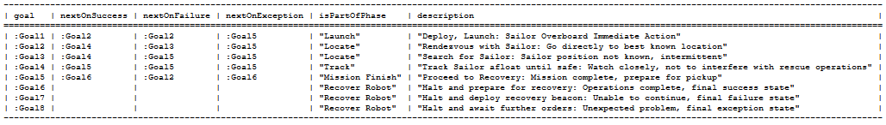
SPARQL query response SailorOverboardConverted. MissionQuery_01_GoalBranches.rq.txt
SPARQL query response
SailorOverboardConverted. MissionQuery_02_InitialGoal.rq.txt

Slide 57
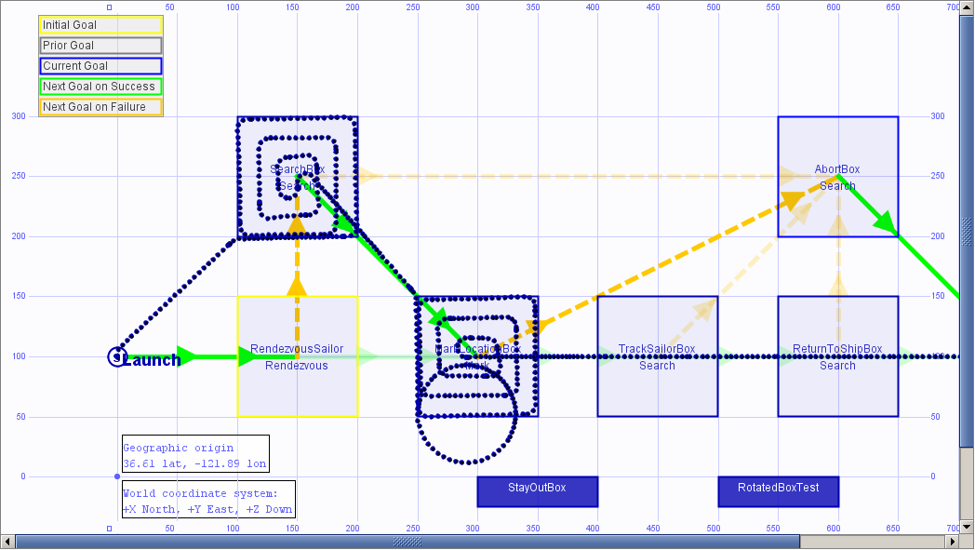
Sailor overboard simulation AUVW
UPDATE IN
PROGRESS

Slide 58
Lifeboat Tracking Mission: Design
Motivations
Similar to Sailor Overboard in demonstrating use of life-saving force.
Far greater distances, over the horizon, increases ship span of control.
Potential for intermittent or lost communications in real time, requires advance guidance for default behaviors desired by human controller.
Consider possible transfer of supervisory control mid-mission to another cooperating vessel – appears feasible.
Lessons learned
Vertical grouping of related subtasks helps in structuring goal sets, without requiring change to ternary logic of AVCL mission goals.
Coexistence of multiple constraints is possible, requires careful thought.

Slide 59
Lifeboat Tracking Mission: Description
Purpose
Provide remote presence for locating, tracking, communications and beaconing.
Phases
Deploy/Launch, Rendezvous, Track Lifeboat, Beacon/Communicate, Return/Recovery.
Human Supervisory Role and Constraints
Monitor, communicate, respond or coordinate rescue effort.
Low fuel condition and graceful-degradation response.

Slide 60
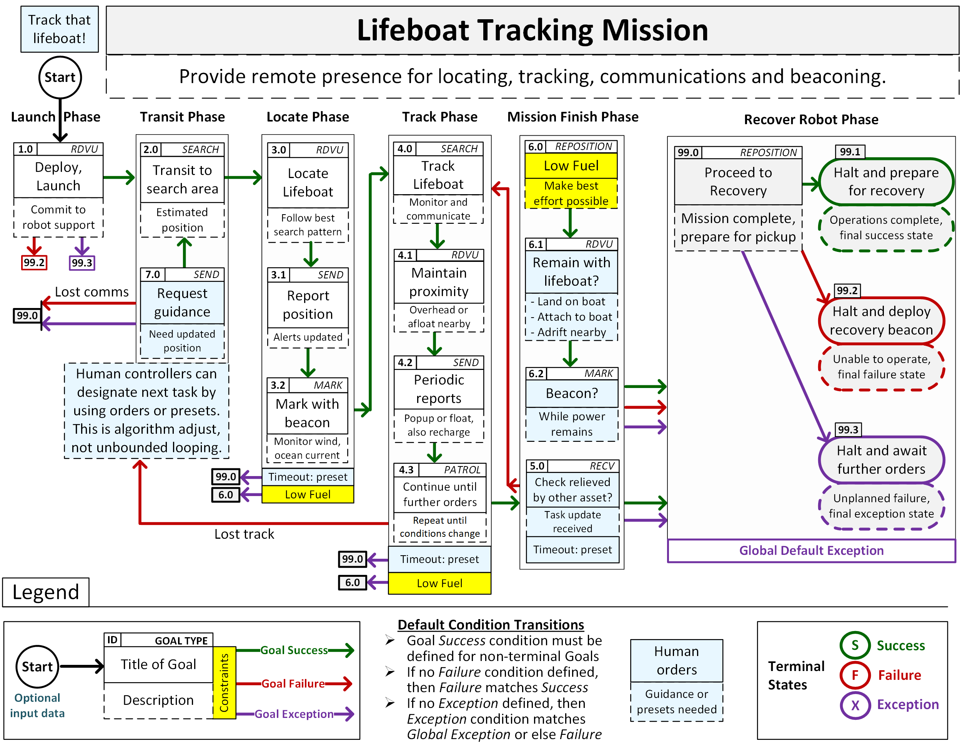
Lifeboat tracking mission

Slide 61
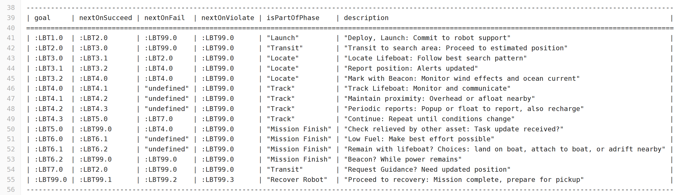
SPARQL query response LifeboatTrackingConverted.MissionGoalsQuery_01_GoalBranches.rq.txt

Slide 62
Pirates Seizing Merchant Mission: Design
Motivations
Necessity to apply lethal force against pirates distant from own ship, corresponding life-saving force potential for hostage merchant crew.
Must operate over long time period, emphasize restraint throughout.
Provide soft and strict supervisory checkpoints for human control.
Lessons learned
Concept of phases helped organize overall mission structure sensibly (approach, warning, attack, recovery).
Looping is necessary, human control checkpoints help avoid deadlock.

Slide 63
Pirates Seizing Merchant Mission: Description
Purpose
Overtake pirate small-boat gang attempting to capture threatened evading merchant ship.
Phases
Deploy/Launch, Search, Approach and Track, Warning, Attack.
Human Supervisory Role and Constraints
Control pace of engagement, careful deliberate escalation.
Confirm IFFNU classification, must order lethal force prior to use.
Low fuel condition and graceful-degradation response.
Low ammunition condition: fight to finish, or stand in reserve?

Slide 64
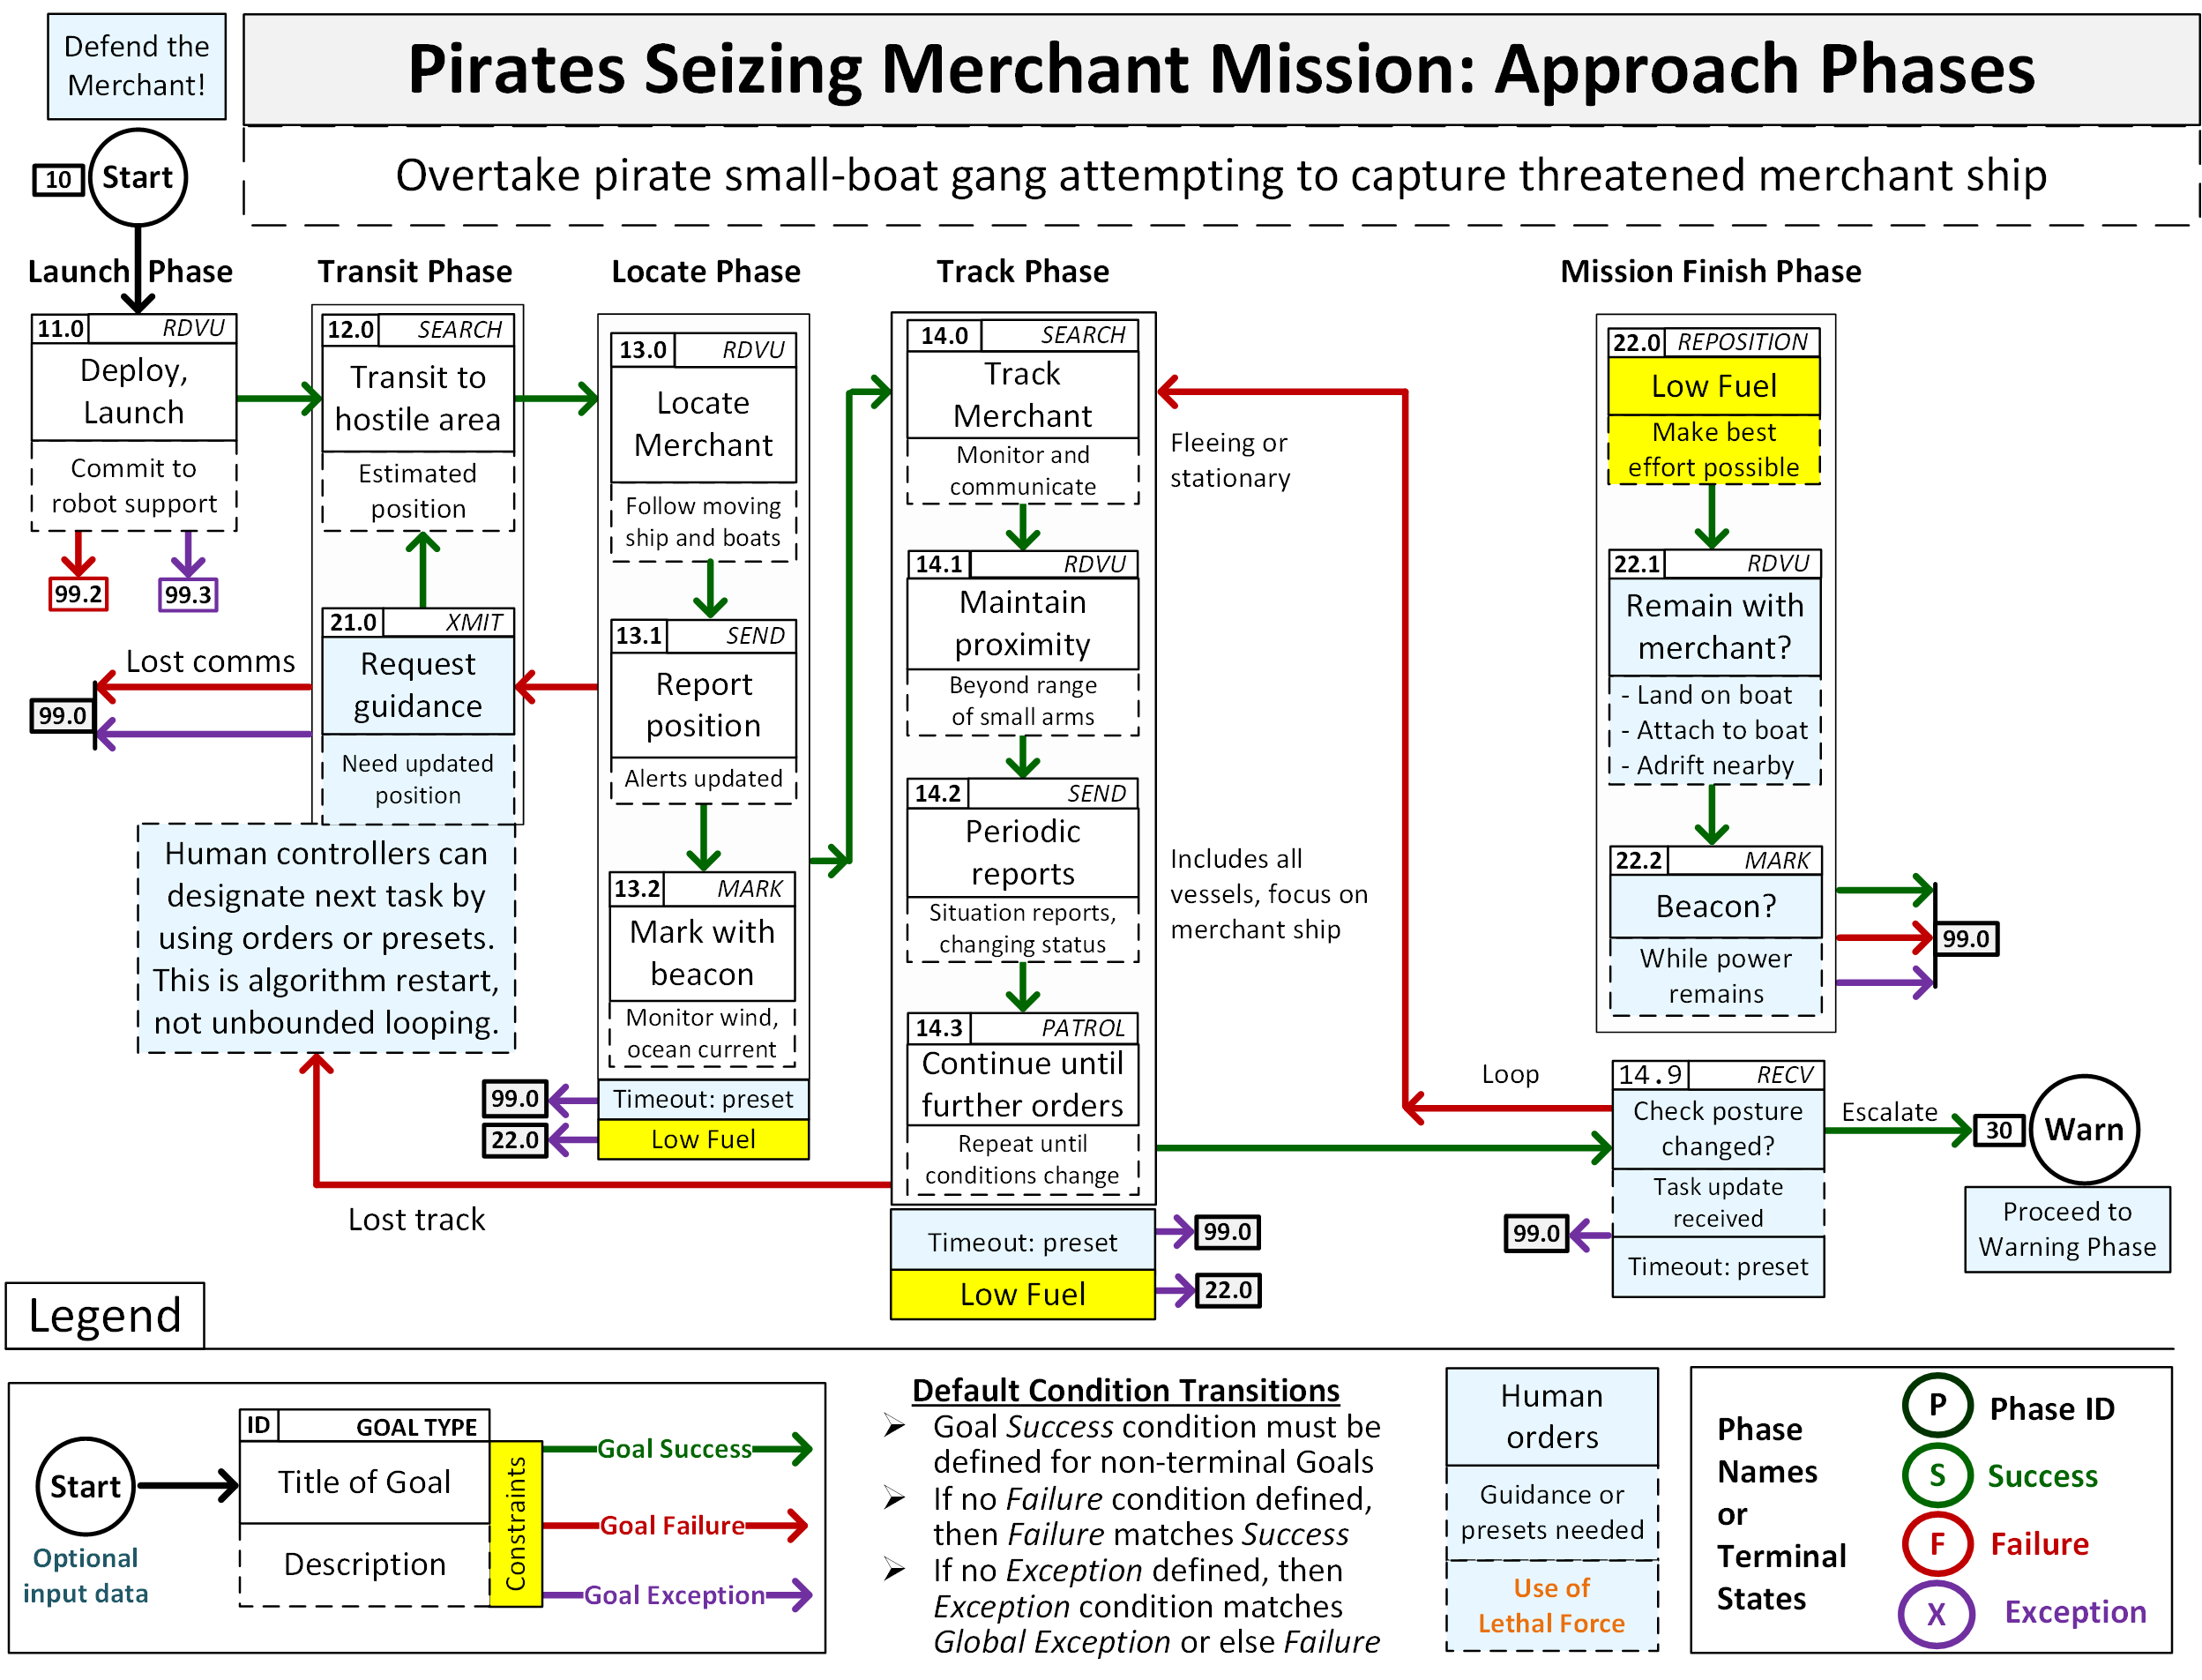
Pirates attack merchant ship 1

Slide 65
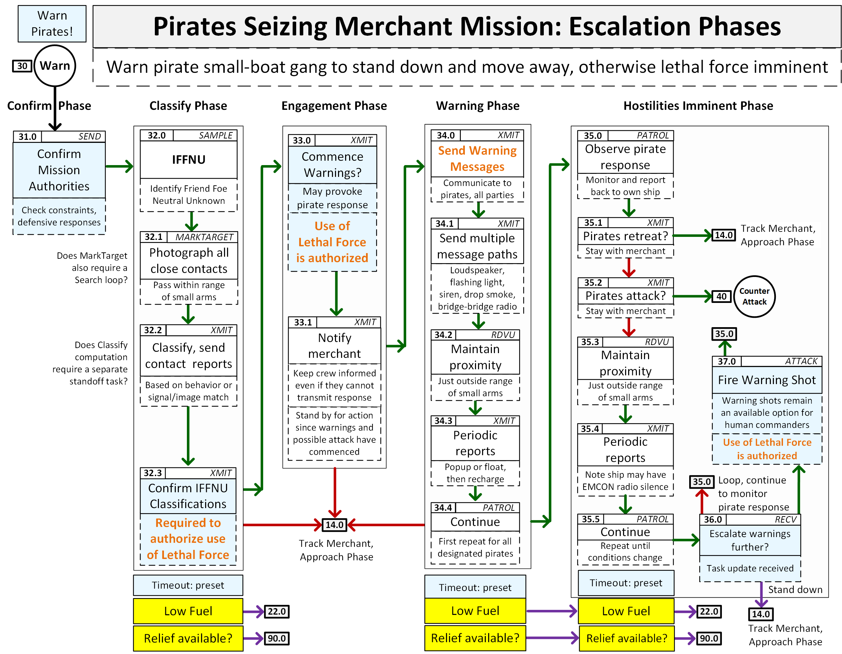
Pirates attack merchant ship 2

Slide 66
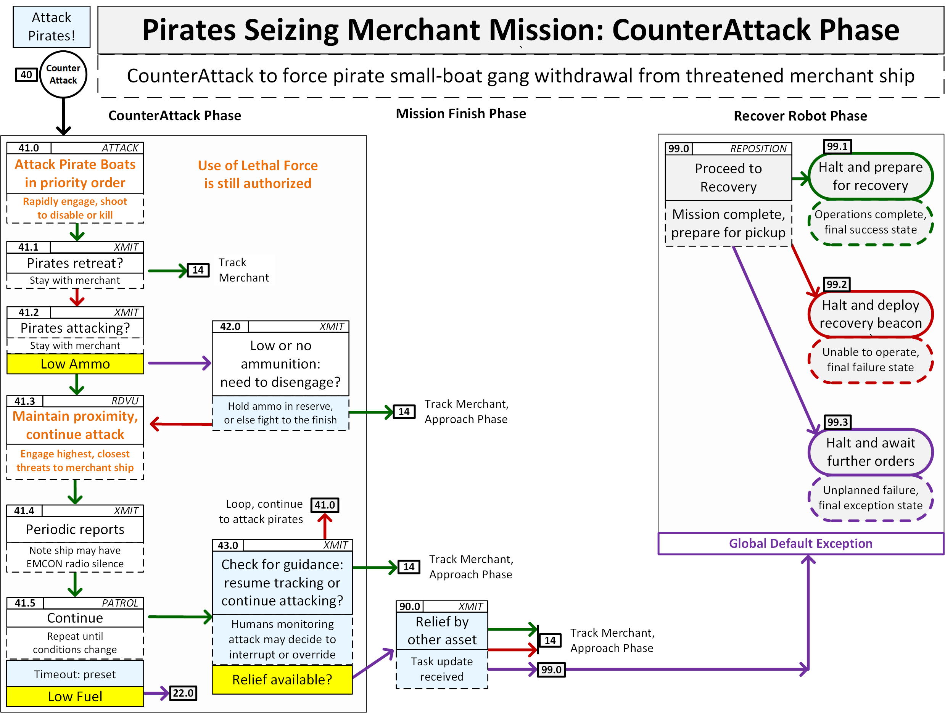
Pirates attack merchant ship 3

Slide 67
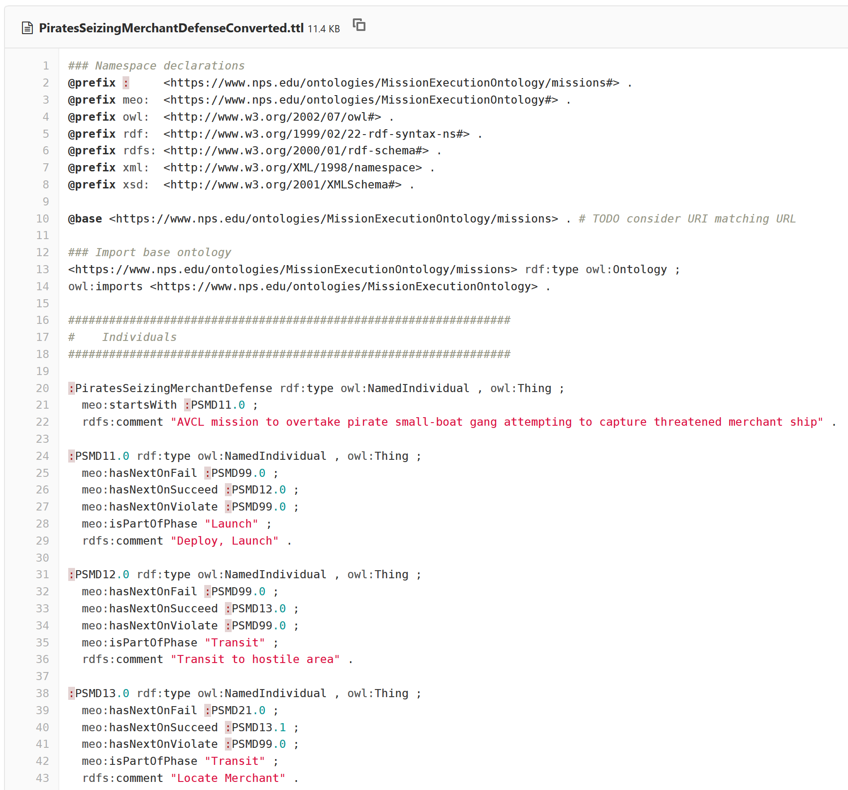
PiratesSeizingMerchantDefenseConverted.ttl Turtle excerpt autogenerated in gitlab.nps.edu version control

Slide 68
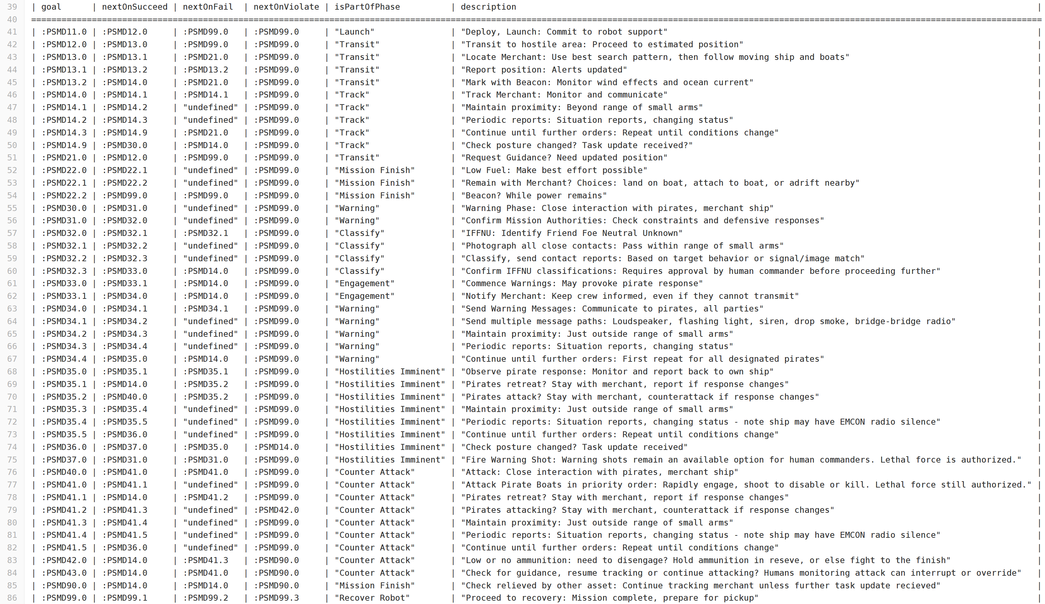
SPARQL query response PiratesSeizingMerchantDefenseConverted.MissionGoalsQuery_01_GoalBranches.rq.txt

Slide 69
Hospital Ship EM Decoy Scenario: Design
Motivations
Simplistic sense-decide-act responses easily exploitable by adversary.
Failure to operate with ethical control results in blue-on-blue damage, self-inflicted war crime, likely stand down of all unmanned systems.
Compare/contrast mission operations with/without ethical control.
Lessons learned
Historical context: False flag scenario where opponent appears friendly.
Comparison with OODA loop principles ensures that human-robot teamed operations are well understood and tactically effective.

Slide 70
Hospital Ship EM Decoy Missions: Description
Purpose: Comparison
Immediate reaction by robot swarm using only Sense-Decide-Act cycle results in unintended blue-on-blue war crime.
Ethical Control constraints (identity, OODA orientation to confirm) prevent automatic counterattack, accelerates defense.
Phases
Set response thresholds, detect threat, counterattack ship or threat.
Human Supervisory Role
Confirm IFFNU classification, must permit lethal force prior to use.

Slide 71
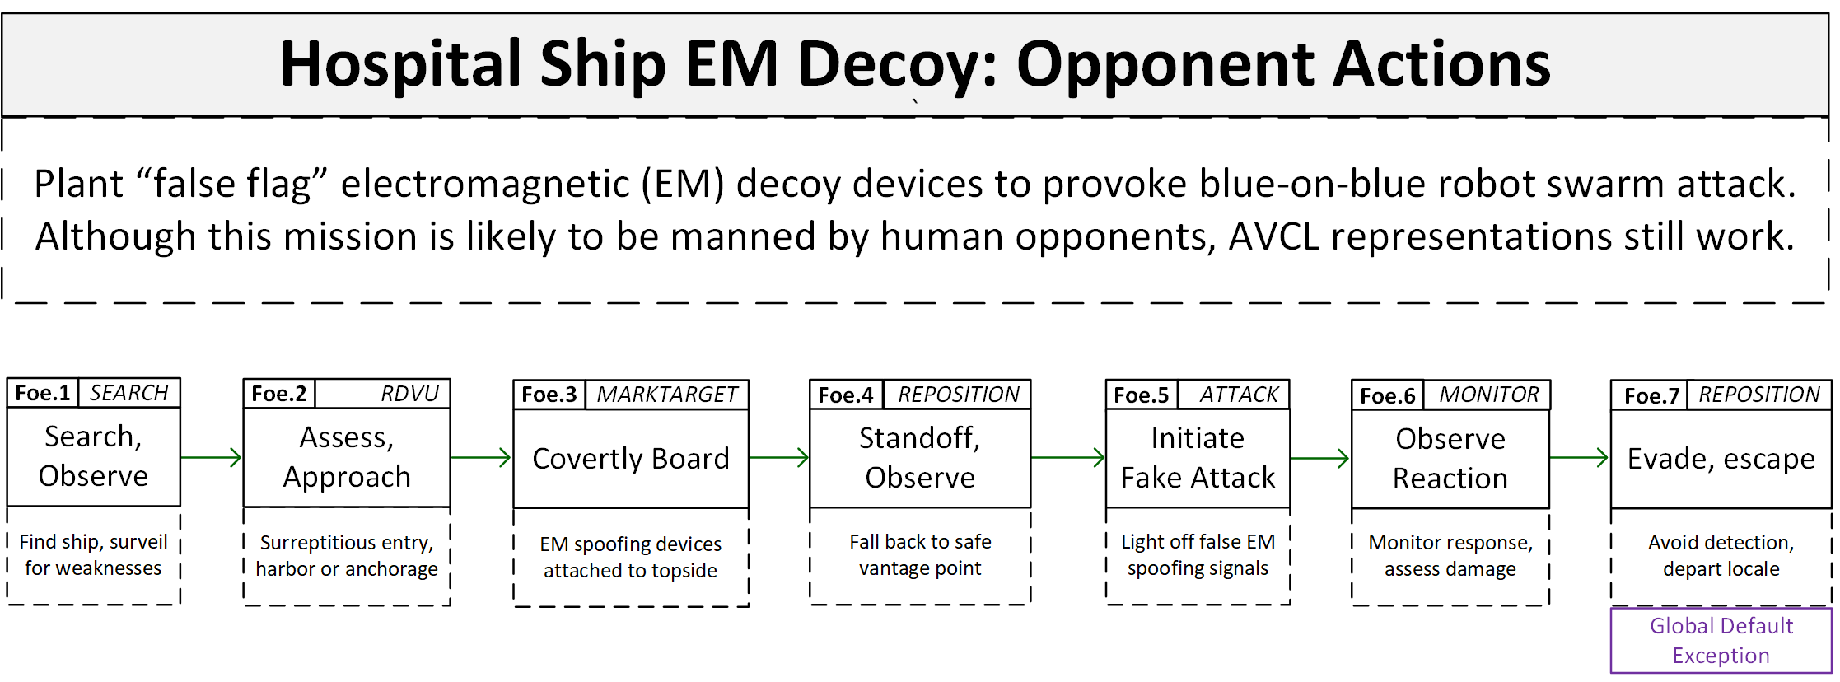
Hospital ship EM Decoy: Opponent Actions
Simple yet effective

Slide 72
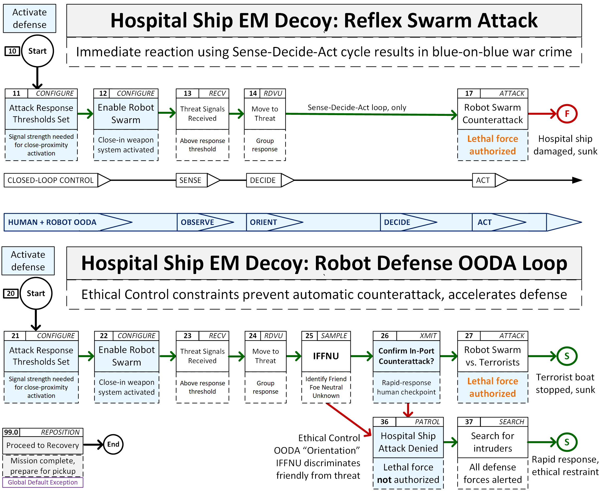
Hospital ship EM Decoy: Robot Responses

Slide 73
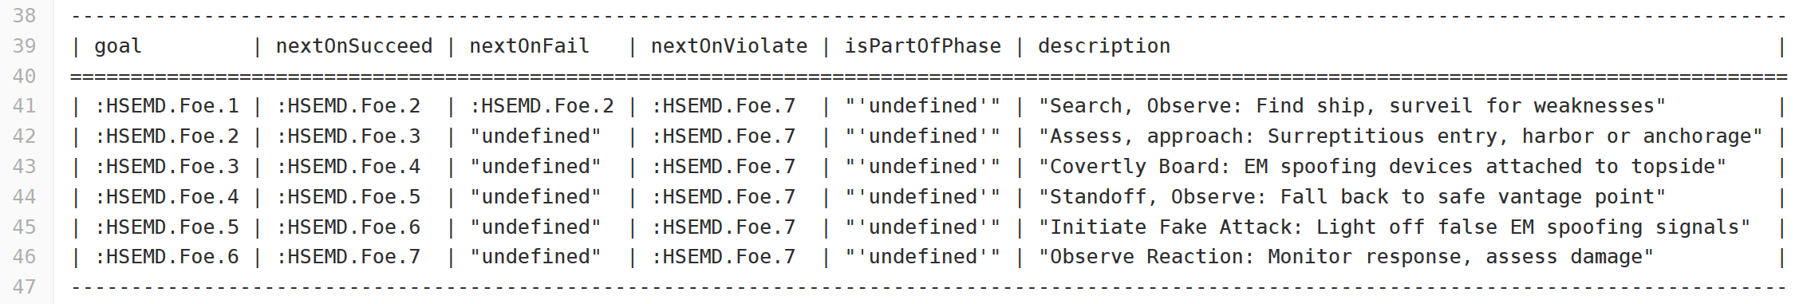
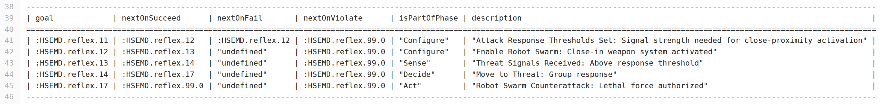
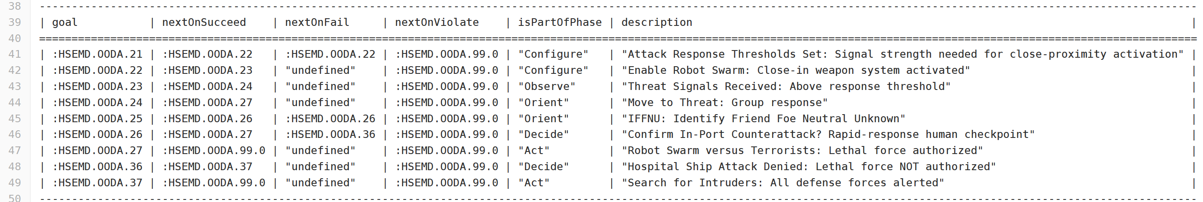
SPARQL query response resultsHospitalShipEmDecoy1.OpponentConverted.MissionGoalsQuery_01_GoalBranches.rq.txt
SPARQL query response HospitalShipEmDecoy2.Defender.SenseDecideActConverted.MissionGoalsQuery_01_GoalBranches.rq.txt
SPARQL query response HospitalShipEmDecoy3.Defender.EthicalControlOODAConverted.MissionGoalsQuery_01_GoalBranches.rq.txt

Slide 74
Simulation and Visualization
Rehearsal, real-time runs and replay are possible using AVCL constructs across multiple representations and programming languages.

Slide 75
Path towards achieving interoperability
Robotic systems tend to be complex codebases with implementations that require strict, idiosyncratic, language-specific programming logic.
In general, system designers can say “here are the requirements”
In general, programmers can say “here’s how we wrote that code”
… but these are not the same, often not even sharing same terms of reference!
Traceable predictability of software logic is difficult, not portable across systems.
… but confirming code capabilities is testable and repeatable across systems.
Key point: strict validation of mission syntax, semantics are both possible!
Patterns of implementation then become demonstrable in different systems,
Human confirmation of mission definitions remains central throughout.

Slide 76
Multiple implementations for scalability
Given the broad diversity of robotic software and hardware systems under development, no single reference codebase is either possible or desirable.
Nevertheless systems can easily parse and utilize well-defined data (orders).
Focusing on formal mission definition for both humans and systems provides a testable middle ground that each can use effectively.
Implementing and evaluating using multiple software implementations also provides strong evidence that design capabilities all work as planned.
… in turn producing corresponding work lists of needed improvements, to help both mission-design clarity and software-implementation correctness.
This project multiple programming paths in tandem, in order to demonstrate that multiple kinds of unmanned systems can adopt it on their own terms.

Slide 77
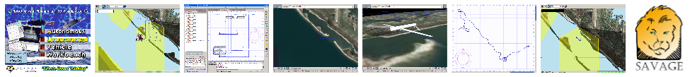
AUV Workbench
Example
open-source
implementation
Autonomous Unmanned Vehicle (AUV) Workbench supports underwater, surface and air vehicles
Rehearsal of physics-based mission response
Real-time task-level control of robot missions, and
Replay of recorded results
Industry-friendly open-source license, Sourceforge
Basis: RBM 3-level architecture, AVCL commands
Used to rehearse strategic-level agenda missions
https://savage.nps.edu/AuvWorkbench

Slide 78
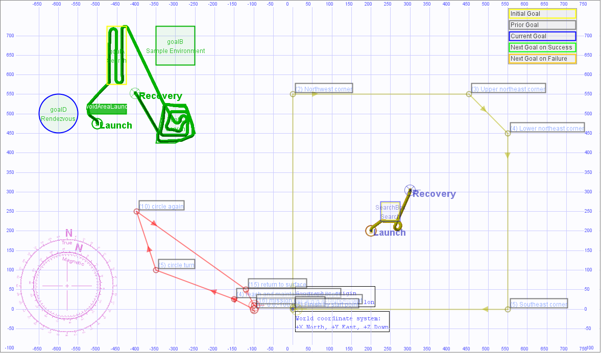
4 earlier example missions, UUV and USV

Slide 79
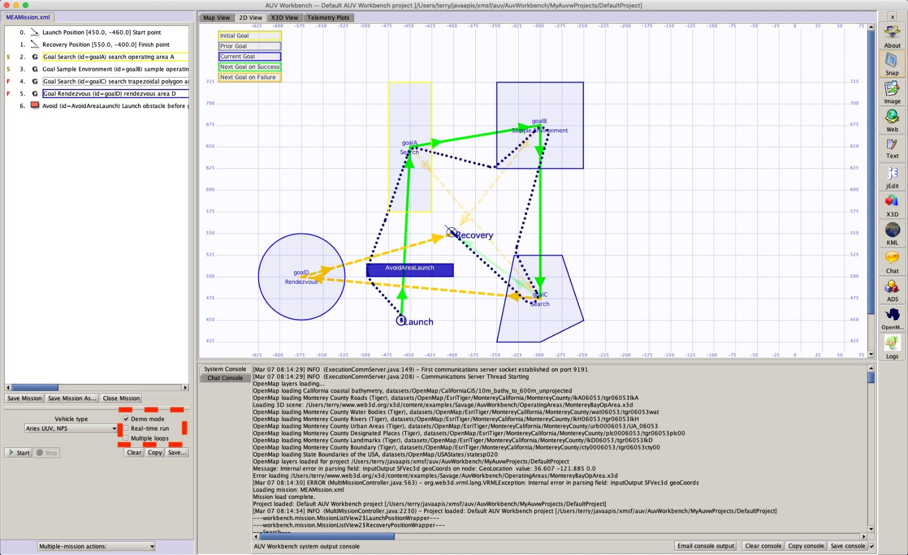
AUV Workbench Demo Mode 2
Example simulation using AUV Workbench

Slide 80
Related resources of interest
This project draws on multiple relevant activities and capabilities. The following synopses are distilled from each respective resource.

Slide 81
Unmanned Maritime Autonomy Architecture (UMAA)
Richard R. Burgess, “Navy Requests Information for Unmanned Maritime Autonomy Architecture,” SEA POWER, 20 FEB 19
“The intent of UMAA is to provide overarching standards that various UUVs and USVs can be built to in order to avoid creating multiple conflicting systems in the future”
“The UMAA is being established to enable autonomy commonality and reduce acquisition costs across both surface and undersea unmanned vehicles.”
Topics of interest include Situational Awareness, Sensor and Effector Management, Processing Management, Communications Management, Vehicle Maneuver Management, Vehicle Engineering Management, Vehicle Computing Management, Support Operations
Multiple public NAVSEA documents refer to autonomy efforts and UMAA.
NAVSEA PMS 406 is Program Office for Unmanned Maritime Systems
NAVSEA Fact Sheet: Unmanned Maritime Systems Program Office (PMS 406) https://www.navsea.navy.mil/Portals/103/Documents/Exhibits/SNA2019/UnmannedMaritimeSys-Small.pdf
Automated Management of Maritime Navigation Safety Navy SBIR 2020.1 - Topic N201-059, https://www.navysbir.com/n20_1/N201-059.htm
Proposed Critical Path Forward

Slide 82

DoD Directive: Autonomy in Weapon Systems
CONTROLLING REFERENCE OVERALL
DoD Directive 3000.09, 21 NOV 2012 with change 1, 8 May 2017
Original and update signed by DEPSECDEF Ashton Carter
1. PURPOSE
a. Establishes DoD policy and assigns responsibilities for the development and use of autonomous and semi-autonomous functions in weapon systems, including manned and unmanned platforms.
b. Establishes guidelines designed to minimize the probability and consequences of failures in autonomous and semi-autonomous weapon systems that could lead to unintended engagements.
4. POLICY (excerpted)
a. Autonomous and semi-autonomous weapon systems shall be designed to allow commanders and operators to exercise appropriate levels of human judgment over the use of force.
b. Persons who authorize the use of, direct the use of, or operate autonomous and semi-autonomous weapon systems must do so with appropriate care and in accordance with the law of war, applicable treaties, weapon system safety rules, and applicable rules of engagement (ROE). […]
6. RELEASABILITY. Cleared for public release. […]

Slide 83
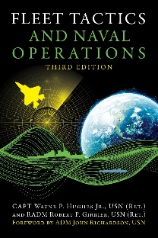
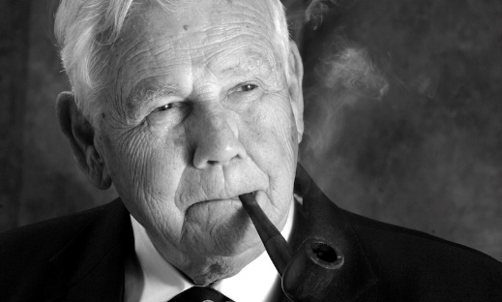
Fleet Tactics and Naval Operations
Wayne P. Hughes, Jr. and Robert P. Girrier, Fleet Tactics and Naval Operations, Third Edition, Naval Institute Press, Annapolis Maryland, June 2018.
https://www.usni.org/press/books/fleet-tactics-and-naval-operations-third-edition
From newly added Chapter 12, A Twenty-First-Century Revolution:
“At the most fundamental level, [Information Warfare] IW is about how to employ and protect the ability to sense, assimilate, decide, communicate, and act – while confounding those same processes that support the adversary.”
“Information Warfare broadly conceived is orthogonal to naval tactics. As a consequence, IW is having major effects on all six processes of naval tactics used in fleet combat – scouting and antiscouting, command-and-control, C2 countermeasures, delivery of fire, and confounding enemy fire.”
“Indeed there is a mounting wave of concern about how far automation will expand and what its impact will be on the continuum of cognition from data to information to knowledge. […] Navies are facing similar uncertainties.”
Wayne Hughes coined the term “Network Optional Warfare” after many discussion sessions, directly contrasting it to Network Centric Warfare. Thank you sir.

Slide 84
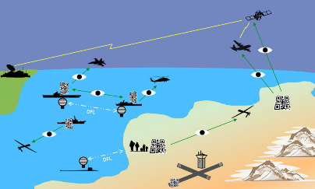
Network Optional Warfare (NOW)
Overall Concept
Naval forces do not have to be engaged in constant centralized communication. Deployed Navy vessels have demonstrated independence of action in stealthy coordinated operations for hundreds of years.
Littoral operations, deployable unmanned systems, and a refactored force mix for surface ships pose a growing set of naval challenges and opportunities. Network-optional warfare (NOW) precepts include Efficient Messaging, Optical Signaling, Semantic Coherence and Ethical Human Supervision of Autonomy for deliberate, stealthy, minimalist tactical communications.
https://wiki.nps.edu/display/NOW/Network+Optional+Warfare

Slide 85
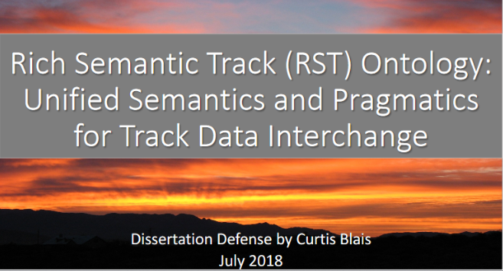
Rich Semantic Track (RST)
Related Work
Curt Blais Dissertation
DoD mandates data sharing practices, but practices have been mixed and uneven, resulting in perpetuation of system-centric data practices.
Sharing and collective understanding of track data - collections of time-stamped perceptions of the state of objects of interest — are critical to warfighting systems.
Shared understanding requires common semantics.
The Rich Semantic Track (RST) ontology provides a foundation for shared understanding of track data.
It is time to change the way DoD manages data and engineers systems, starting with adoption of the RST ontology and moving toward the vision of a Web of linked track data.
Network Optional Warfare (NOW) Semantic Coherence
Rich Semantic Track (RST)

Slide 86
Coactive Design and Interdependency Analysis
Matthew Johnson and Alonso Vera, “No AI is an Island: The Case for Teaming Intelligence”, AI Magazine, vol. 40 no.1, Spring 2019
Abstract. “The purpose of this article is to draw attention to an aspect of intelligence that has not yet received significant attention from the AI community, but that plays a crucial role in a technology’s effectiveness in the world, namely teaming intelligence. We propose that Al will reach its full potential only if, as part of its intelligence, it also has enough teaming intelligence to work well with people. Although seemingly counterintuitive, the more intelligent the technological system, the greater the need for collaborative skills. This paper will argue why teaming intelligence is important to AI, provide a general structure for AI researchers to use in developing intelligent systems that team well, assess the current state of the art and, in doing so, suggest a path forward for future AI systems. This is not a call to develop a new capability, but rather, an approach to what AI capabilities should be built, and how, so as to imbue intelligent systems with teaming competence.”
Strong resonances exist with Ethical Control that deserve further exploration.

Slide 87
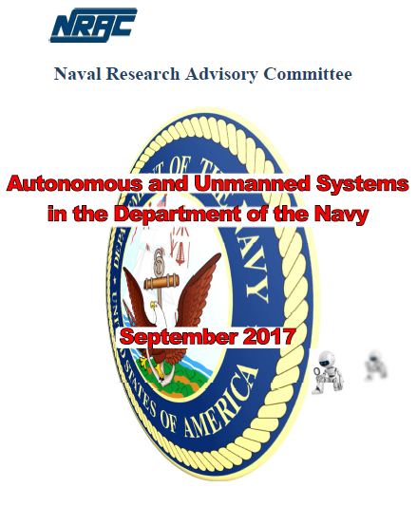
Naval Research Advisory Committee (NRAC)
“Autonomous and Unmanned Systems in Department of Navy”
Technical Report, September 2017
Chair: Dr. James Bellingham, Director of Center for Marine Robotics, Woods Hole Oceanographic Institute (WHOI). Former Chief Technologist at Monterey Bay Aquarium Research Inst. (MBARI)
https://www.nrac.navy.mil/docs/2017_rpt_Autonomous_Unmanned_Systems_Don-SEP2017.pdf
Recommendation #1: create comprehensive data plan to field autonomy.
“DoN must urgently develop an organizational data plan.”
“In the future, data will win wars.”
“Data is ultimate ‘component’ for AI systems and must be controlled.”

Slide 88
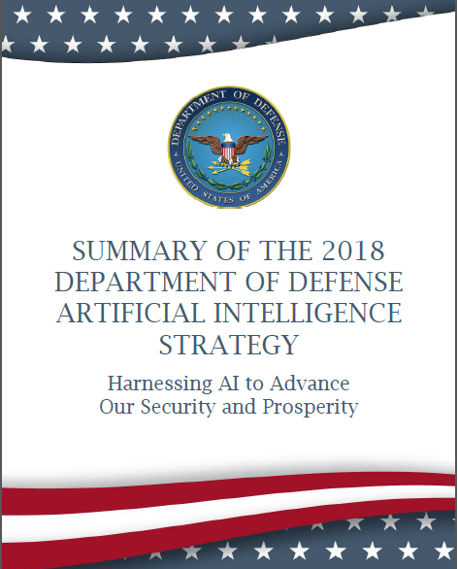
DoD Artificial Intelligence (AI) Strategy February 2019
https://media.defense.gov/2019/Feb/12/2002088963/-1/-1/1/SUMMARY-OF-DOD-AI-STRATEGY.PDF
“Leading in military ethics and AI safety. The Department will articulate its vision and guiding principles for using AI in a lawful and ethical manner to promote our values. We will consult with leaders from across academia, private industry, and the international community to advance AI ethics and safety in the military context. We will invest in the research and development of AI systems that are resilient, robust, reliable, and secure; we will continue to fund research into techniques that produce more explainable AI; and we will pioneer approaches for AI test, evaluation, verification, and validation. We will also seek opportunities to use AI to reduce unintentional harm and collateral damage via increased situational awareness and enhanced decision support. As we improve the technology and our use of it, we will continue to share our aims, ethical guidelines, and safety procedures to encourage responsible AI development and use by other nations.”
Terri Moon Cronk, “DOD Unveils Its Artificial Intelligence Strategy”, Defense.gov
Execution:

Slide 89

Defense Innovation Board (DIB) AI Principles Project
https://innovation.defense.gov/ai (Primary Document) (Supporting Document)
“We have witnessed how deeply committed the women and men who work in the Department are to ethics: avoiding civilian casualties, adhering to international humanitarian law, and collaborating with allies in international fora to advance international law and norms. Additionally, the Department extensively tests all its systems, especially weapons systems, and systems employing AI will likely be subjected to more scrutiny than ever before.”
“The DIB noted that -- as with all new technologies -- rigorous work is needed to ensure new tools are used responsibly and ethically. The stakes are high in fields such as medicine or banking, but nowhere are they higher than in national security.”
Approved by DIB on 31 OCT 2019

Slide 90

Joint Artificial Intelligence Center (JAIC) https://www.ai.mil
DoD CIO Joint Artificial Intelligence Center (JAIC) tasked to execute DoD AI Strategy.
JAIC’s Guiding Tenets:
AI is critical to the future of United States’ national security, and the JAIC is the focal point for the execution of the DoD AI Strategy.
We exist to create and enable impact for the Armed Services and DoD Components across the full range of their missions – from back office to front lines of the battlefield.
Leadership in ethics and values is core to everything we do at the JAIC.
The JAIC attracts the best and brightest people from across DoD, commercial industry, and academia. When they get here, they are empowered to bring their expertise to the Department’s transformation.
Ethical Principles for AI: Responsible, Equitable, Traceable, Reliable, Governable.

Slide 91
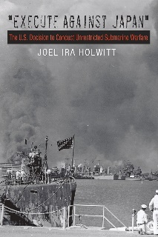
Execute Against Japan – The US Decision To Conduct Unrestricted Submarine Warfare
Joel Ira Holwitt, Texas A+M University Press
“ . . . until now how the Navy managed to instantaneously move from the overt legal restrictions of the naval arms treaties that bound submarines to the cruiser rules of the eighteenth century to a declaration of unrestricted submarine warfare against Japan immediately after the attack on Pearl Harbor has never been explained. Lieutenant Holwitt has dissected this process and has created a compelling story of who did what, when, and to whom.”—The Submarine Review
“Execute against Japan should be required reading for naval officers (especially in submarine wardrooms), as well as for anyone interested in history, policy, or international law.” — Adm. James P. Wisecup, President, US Naval War College (for Naval War College Review)
“Although the policy of unrestricted air and submarine warfare proved critical to the Pacific war’s course, this splendid work is the first comprehensive account of its origins—illustrating that historians have by no means exhausted questions about this conflict.”—World War II Magazine
“US Navy submarine officer Joel Ira Holwitt has performed an impressive feat with this book. . . Holwitt is to be commended for not shying away from moral judgments . . . This is a superb book that fully explains how the United States came to adopt a strategy regarded by many as illegal and tantamount to ‘terror’.”—Military Review

Slide 92
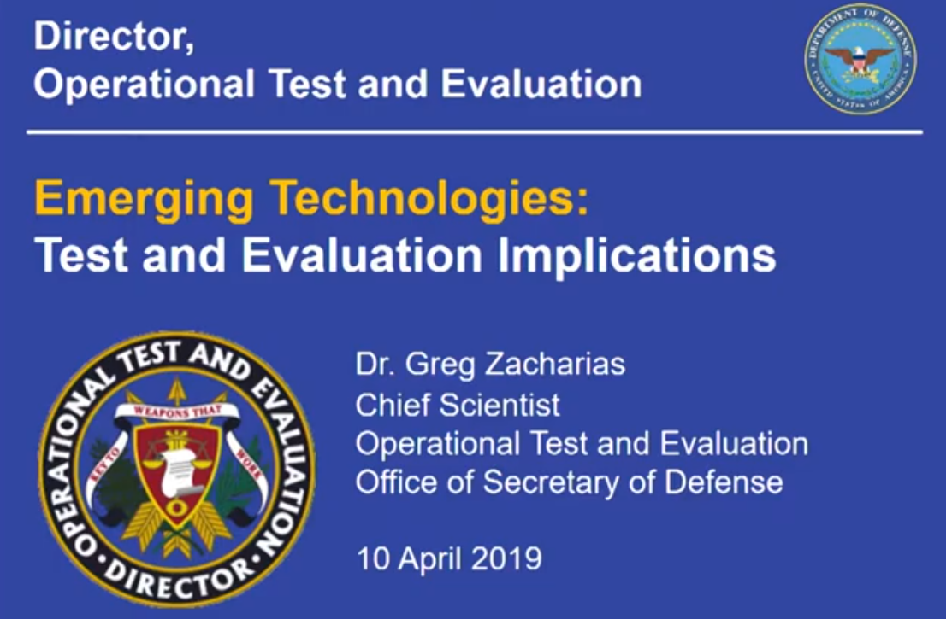
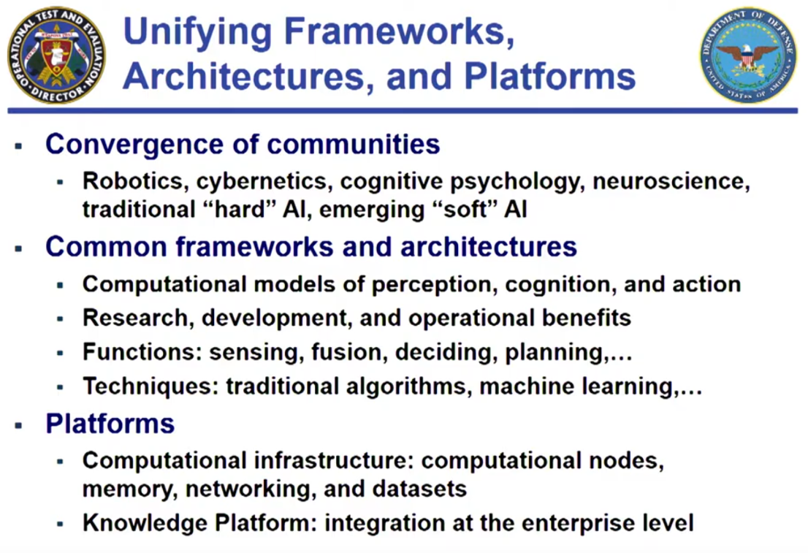
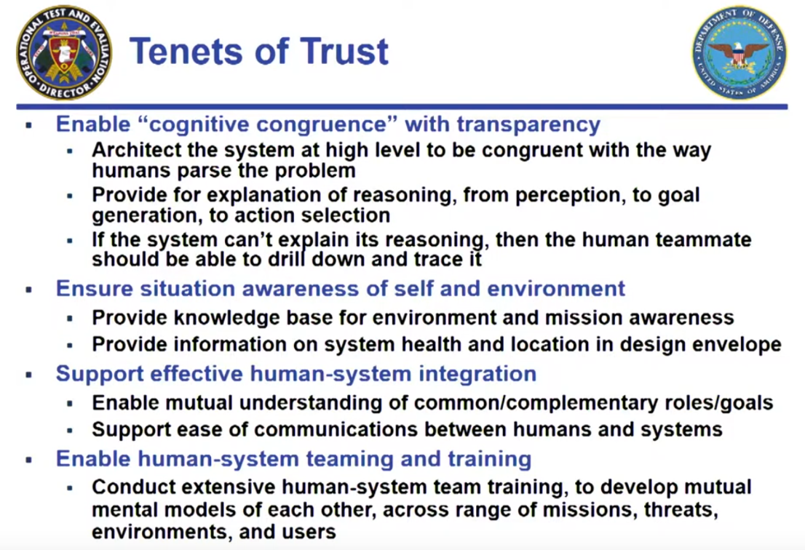
Greg Zacharias: Emerging Technologies, Test and Evaluation (T&E) Implications
Presentation at Institute for Defense Analyses (IDA)
https://www.youtube.com/watch?v=HtFJzua3xXM
July 2019, Alexandria Virginia
Test and evaluation (T&E) of emerging unmanned systems holds many challenges beyond current paradigms for operations, assessment and analysis.
Shared approaches are essential and trust is central for effective human-system teaming across enterprise.

Slide 93

Autonomy & Autonomous Unmanned Systems” Overview, Investment Approach, Opportunities
Jason Stack, Office of Naval Research (ONR), Autonomy Portfolio
Presentation to National Academy of Sciences (NAS) 26 NOV 2019
Comprehensive review of multiple concerns, capabilities, challenges and opportunities
Policy
The United States has policy for all weapon systems to ensure legal and ethical employment Law of Armed Conflict: Distinction, Proportionality, & Military Necessity
Decisions to use lethal force are made by humans at the appropriate level of command based on military result and risk
Weapon systems employing autonomy and automation are governed under exactly the same framework of legal and ethical concerns
Challenge
As more advanced autonomy and artificial intelligence emerges, further thought and clarification is needed to ensure the nature of the technology & usage remains legally & ethically consistent

Slide 94

Navy Large Unmanned Surface and Undersea Vehicles: Background and Issues for Congress
Congressional Research Service, 28 July 2020
(excerpted from abstract) The Navy in FY2021 and beyond wants to develop and procure three types of large unmanned vehicles (UVs). […] The Navy’s large UV programs pose a number of oversight issues for Congress, including issues relating to the analytical basis for the more distributed fleet architecture; [… and …] potential implications for miscalculation or escalation at sea”
“An incident without any immediate human presence or losses could nonetheless trigger unexpected escalation and spark the next conflict.”
Ronald O’Rourke, Specialist in Naval Affairs

Slide 95


Project report published DTIC
Notes:
https://calhoun.nps.edu/handle/10945/65637

Slide 96
Conclusions and Recommendations
Much progress accomplished, and many opportunities becoming possible. Comprehensive pursuit of multiple integrated capabilities is essential.

Slide 97
Assessment of Current Thinking
Human supervision of potentially lethal autonomous systems is a matter of serious global importance.
Wide consensus is emerging on principles, aspects of the problem, elements of solutions, and need to achieve better capabilities.
Much philosophical concern but few concrete activities are evident.
Ethical Control of Unmanned Systems project appears to provide a needed path towards practice, with the historic role of warfighting professionals more central than ever as weapons autonomy grows.

Slide 98
Conclusions
Human supervision is required for any unmanned systems holding potential for lethal force.
Cannot push “big red shiny AI button” and hope for best – immoral, unlawful.
Similar imperatives exist for supervising systems holding life-saving potential.
Human control of unmanned systems is possible at long ranges of time-duration and distance through well-defined mission orders.
Readable and sharable by both humans and unmanned systems.
Validatable syntax and semantics through understandable logical constraints.
Testable and confirmable using simulation, visualization, perhaps qualification.
Coherent human-system team approach is feasible and repeatable.
Semantic Web confirmation can ensure orders are comprehensive, consistent.
Human role remains essential for life-saving and potentially lethal scenarios.

Slide 99
Recommendations for Future Work
Continued development
Diverse mission exemplars
Software implementations
2D, 3D visualization of results
Future capabilities
Automatable testing
Field experimentation (FX)
“Qualification” of unmanned systems in virtual environments
Outreach
Presentations, publication review
Engagement in key ethical forums
NPS wargame and course support
NPS thesis and dissertation work
Adoption
Support for developmental system
Influence campaign for both C4I and robotics communities of interest

Slide 100
Where must we go next
Massive testing of unmanned hardware + software ability to follow both orders and constraints in physically realistic virtual environments.
Certify capabilities via field experimentation (FX), confirmed by USW range exercises and regular force operations.
Human warfighters and commanders (not just engineers) review and approve unmanned systems as… qualified.
New normal will be human + machine teaming. Mainstream capabilities in all aspects of acquisition and deployment.

Slide 101
Acknowledgements
This work builds upon 3 decades of inquiry by NPS faculty, staff and graduate/doctoral students serving on active duty.
Co-investigators Dr. Curtis Blais and Dr. Robert B. McGhee. CRADA leads RADM Jerry Ellis USN (Ret.) and Julie Leeman, Raytheon Technologies.
Research support by Raytheon Missile Systems (RMS) and Raytheon BBN Technologies (Tucson Arizona and Arlington Virginia) has been instrumental in recent progress during 2019-2020.
Significant contributions by Hsin-Fu “Sinker” Wu, Richard Markeloff and others at Raytheon, supporting current work under CRADA with NPS.
Work with Dr. Jakub Flotyński on X3D Ontology for Semantic Web was an essential prerequisite to the capabilities demonstrated here.
Collaborative design efforts with numerous skilled engineers and scientists is gratefully acknowledged. Further activity is welcome.

Slide 102
Contact
Don Brutzman
brutzman@nps.edu
http://faculty.nps.edu/brutzman
Code USW/Br, Naval Postgraduate School
Monterey California 93943-5000 USA
1.831.656.2149 work
1.831.402.4809 cell
Notes:
Questions and feedback are always welcome. Thanks for considering the possibilities.

Slide 103

Ethical Control flyer

